Slide 1



Young Carers
Assembly created with help from a group of school-age Young Carers

Slide 2
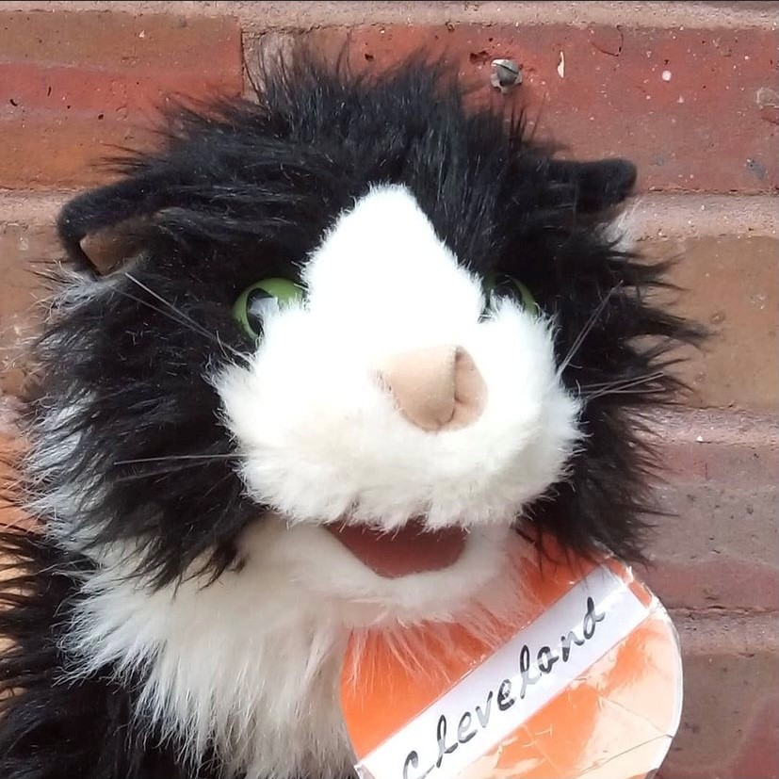
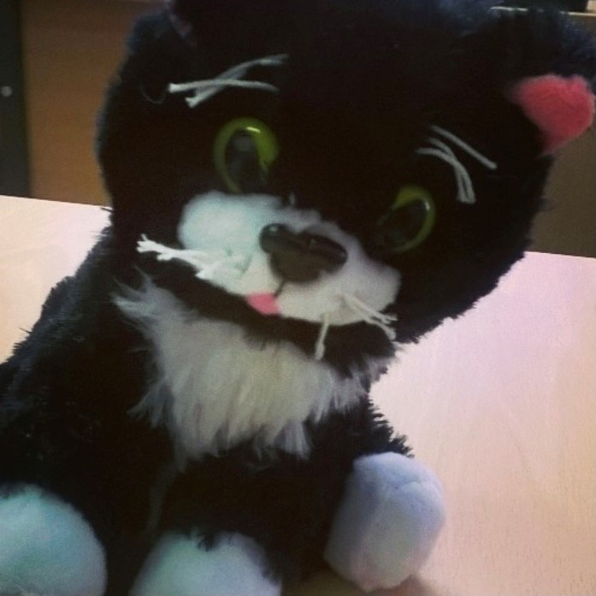
A big hello…
from Cleveland & Tokyo!

Slide 3
Who we work with
We work with children at any age.
Every family is different.
Young carers help lots of different family members including:
Sister / Brother
Parent
Grandparent
Other family member
Close friend / neighbour
This might be because they have:
A disability or have been unwell for a long time
Additional needs
An addiction

Slide 4
What a Young Carer might do
Young Carers do lots of different things to help at home, including:
Getting themselves up and ready for school
Helping with cleaning/cooking/laundry
Supporting someone with getting washed/dressed
Fetching things around the house
Worrying about someone not being ok when you’re not with them or seeing them upset

Slide 5
How we can help you
Visit
We will talk to about being a young carer and how this can affect you
We make a plan about what might help you and who else can support your family
We will also check on you to see if things have changed and if you need any more help.

Slide 6
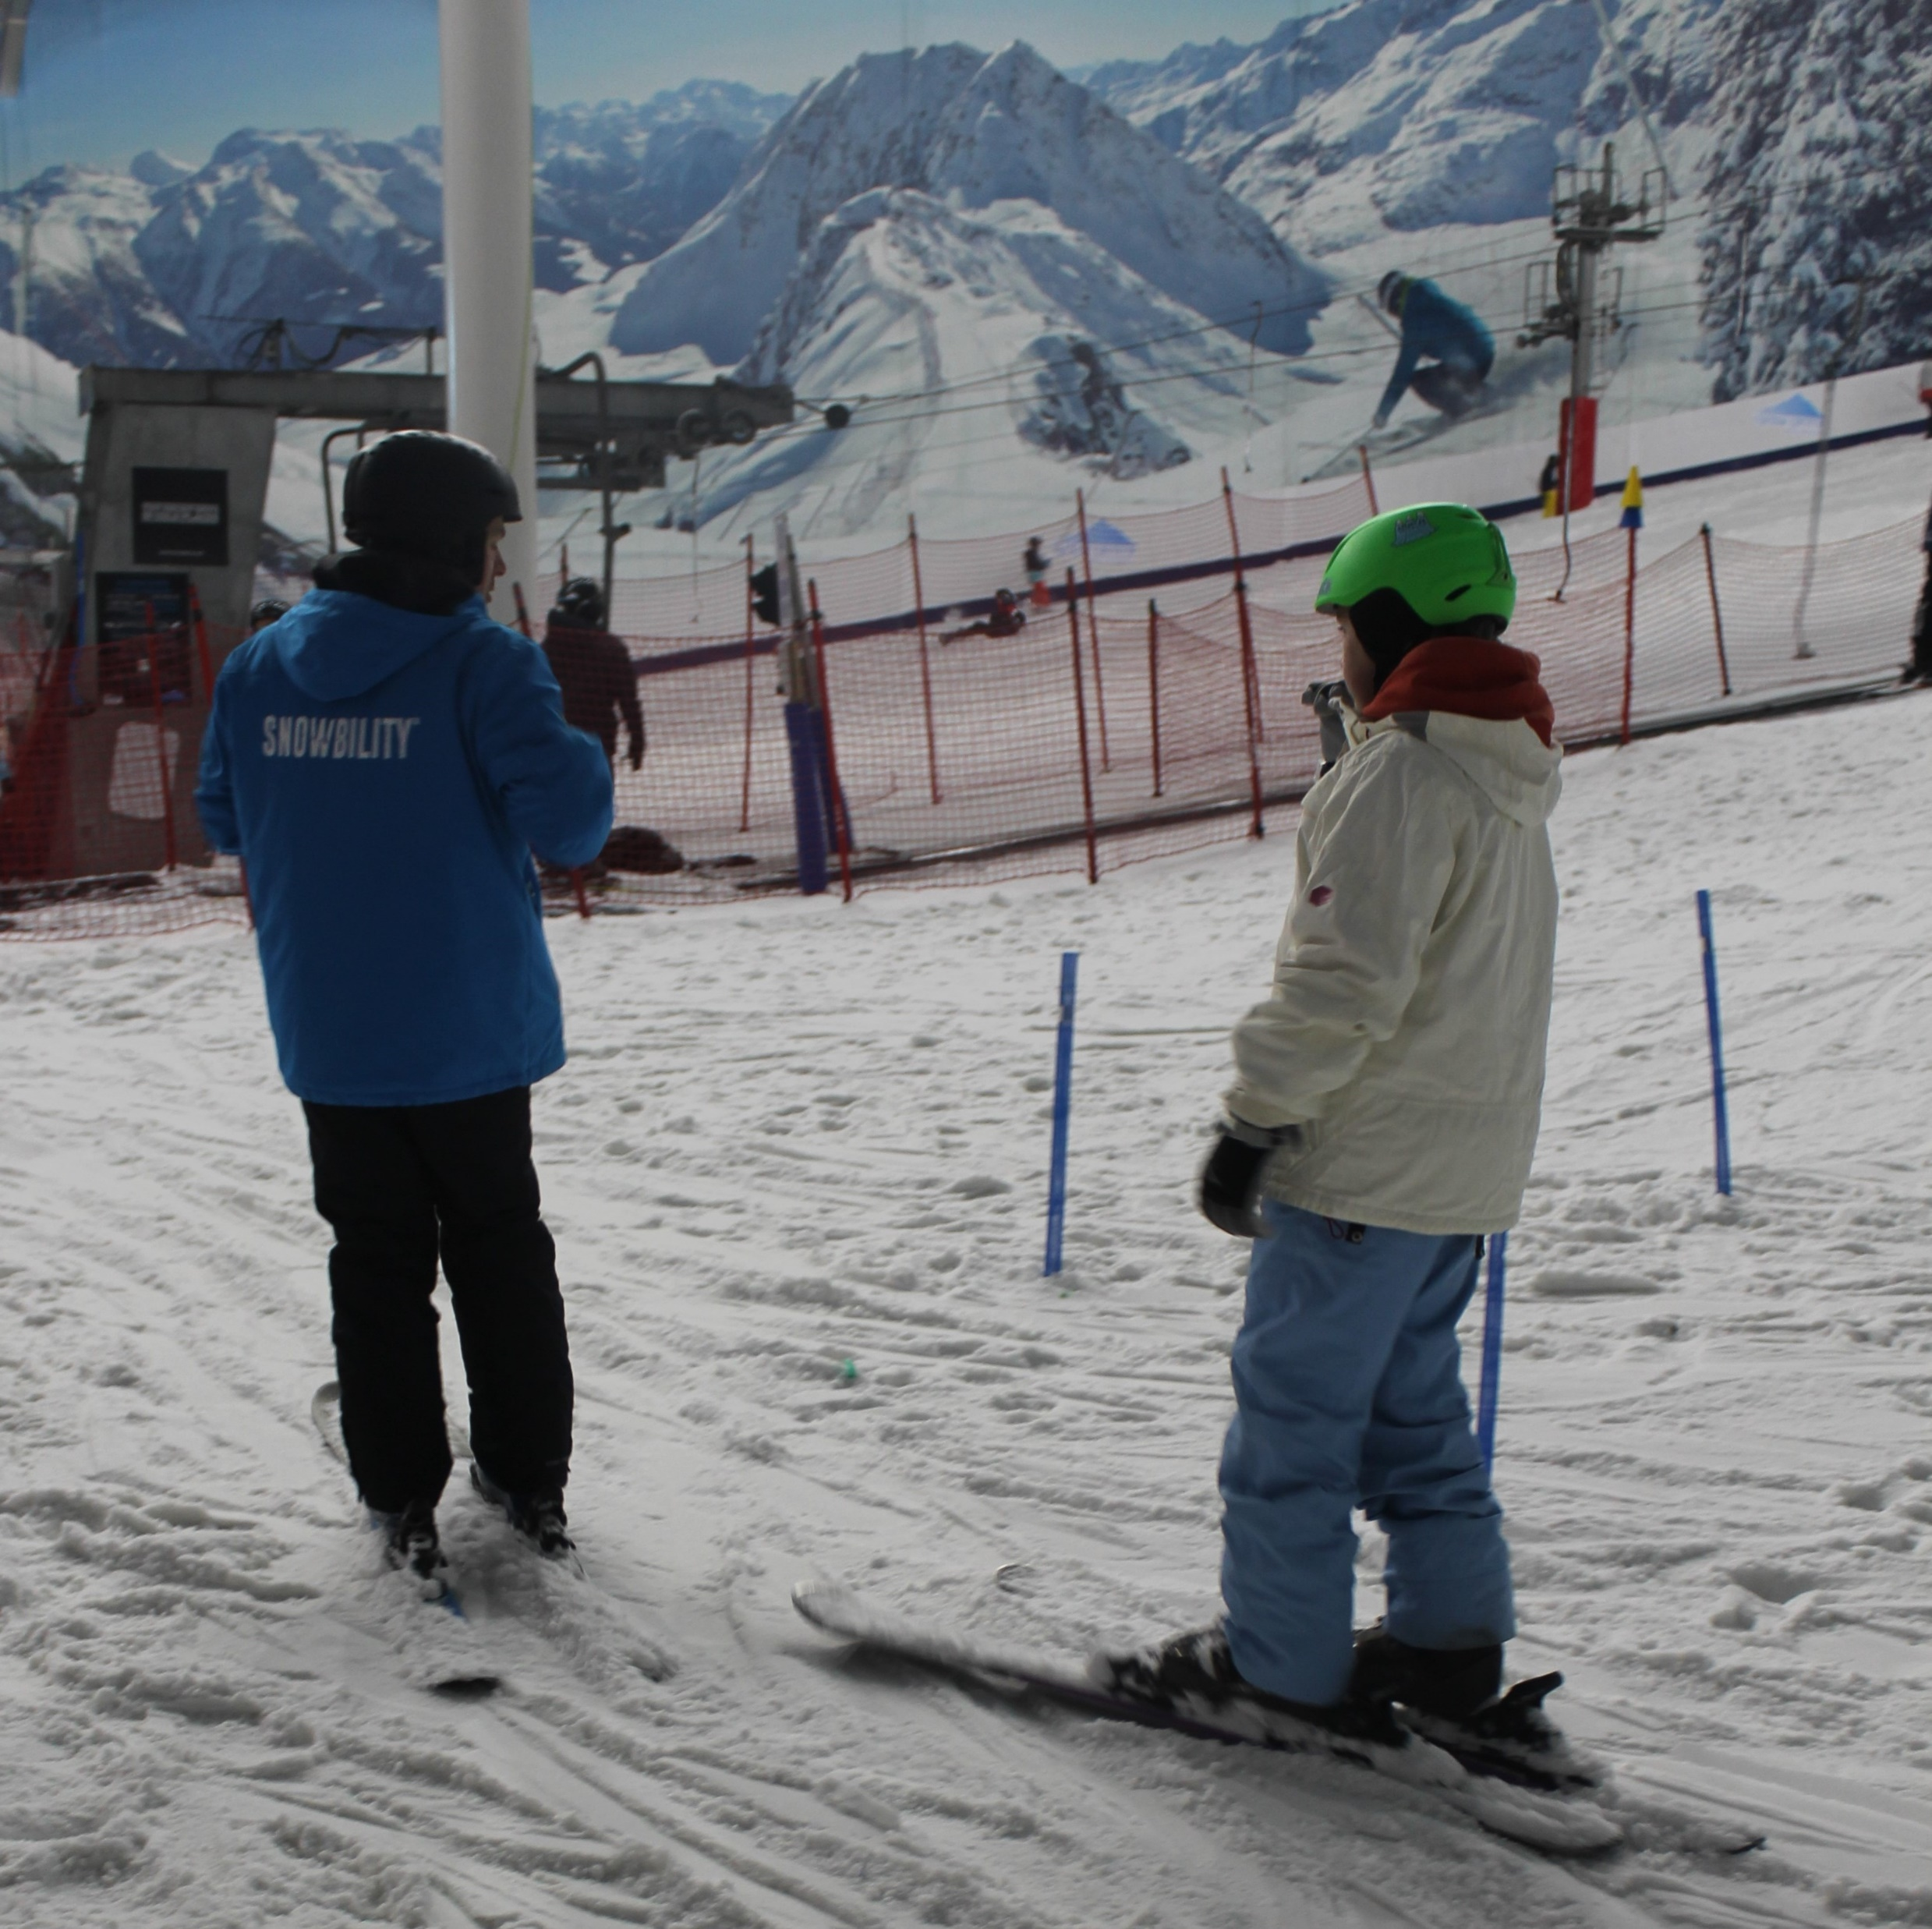
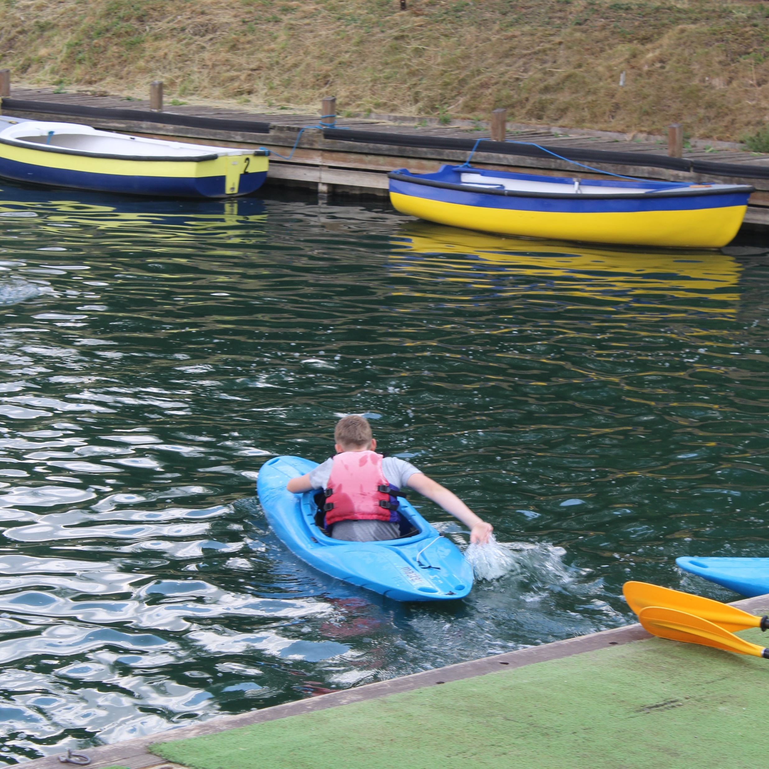
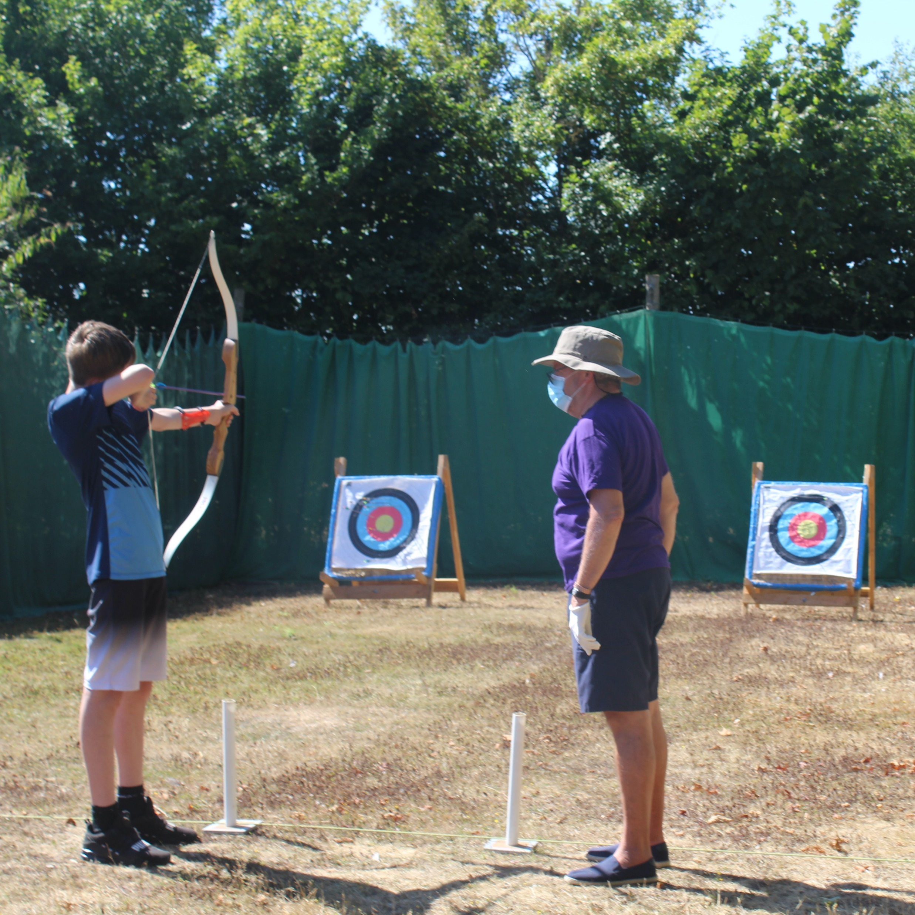
What you can get involved with:
Activities & Residentials
This year we have done: archery, kayaking, crafting, indoor skiing, lawn bowls, art, badminton… and more!

Slide 7
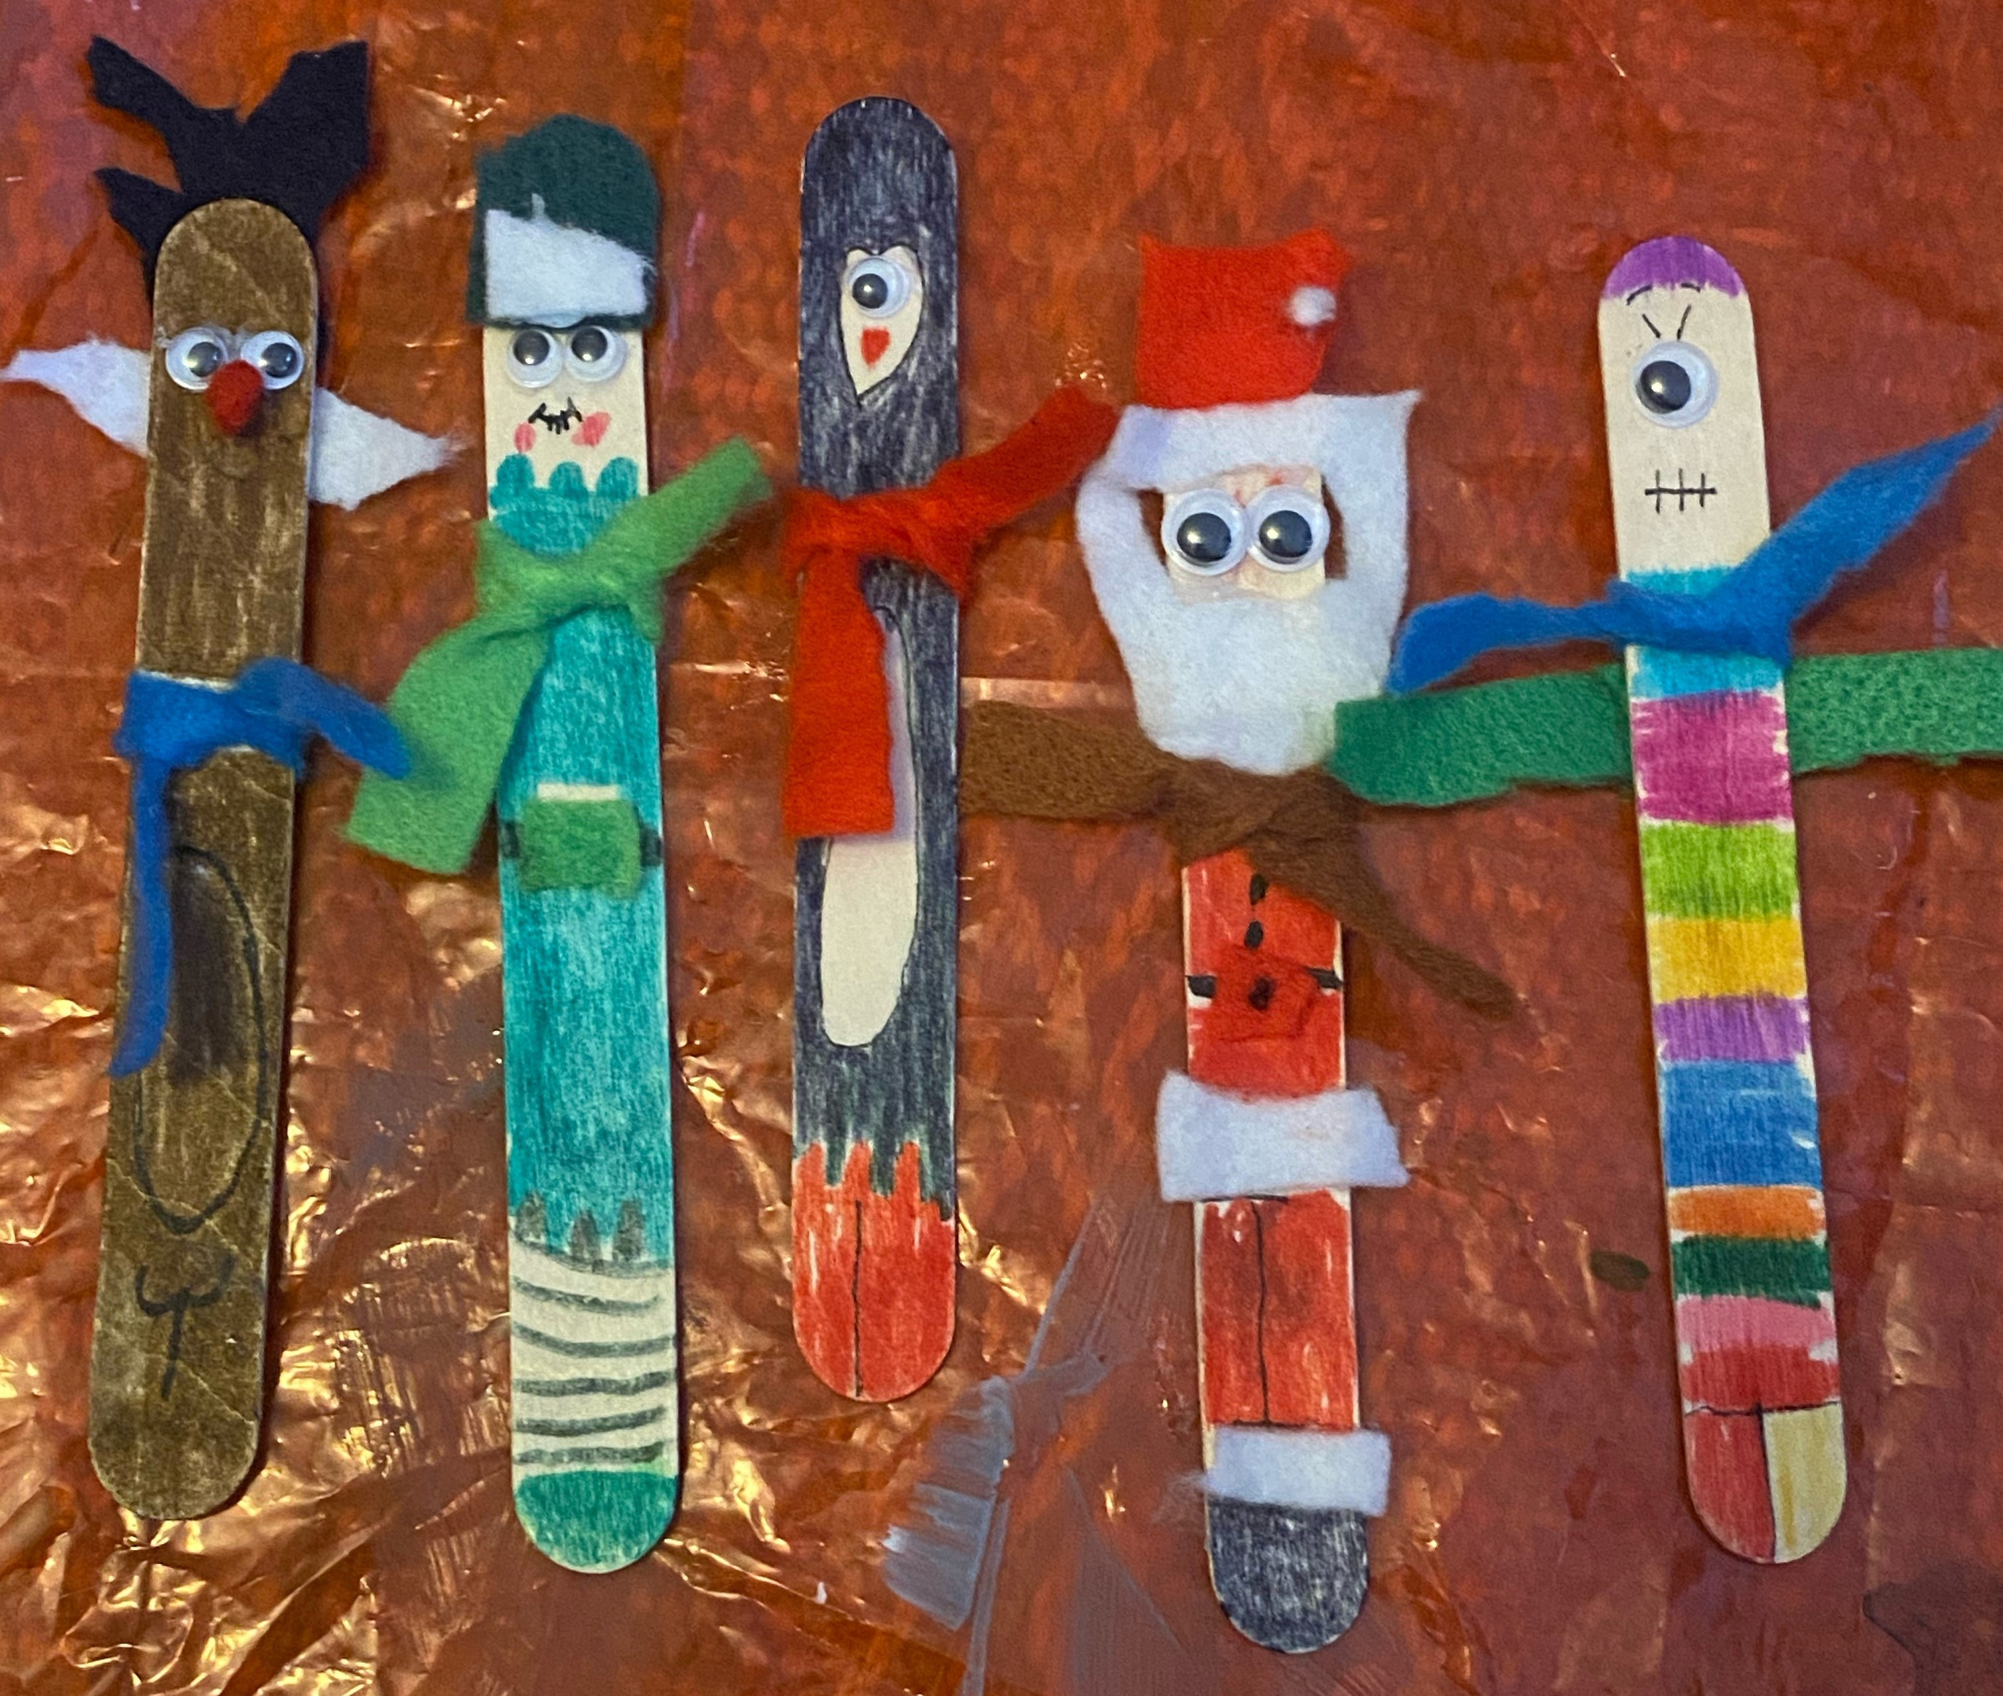
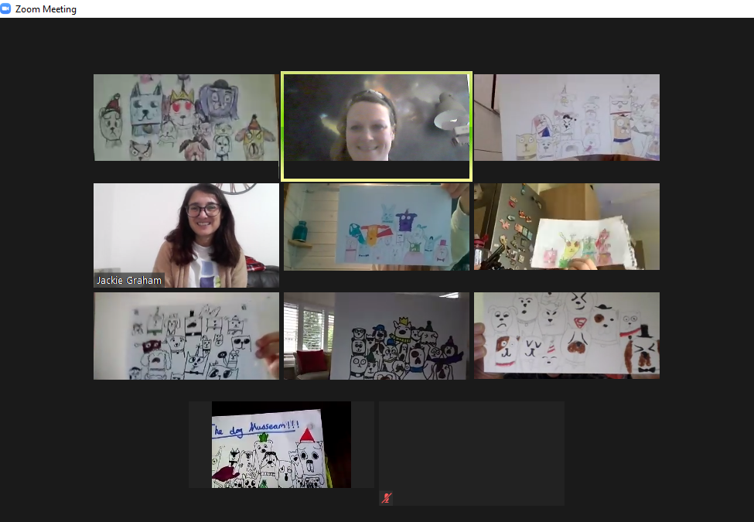
Young Carers Council
Carers Passport discount card
Virtual activities
Young Carers Annual Conference
This year: ‘This is Real Life…’ theme, 100 Young Carers, six different workshops including drumming, cooking, upcycling and art

Slide 8
Young Carer quotes:
What would help? To get a rest from caring
I am worried about my them a lot
I find it hard to concentrate
What would help? Meeting up with other young carers
It makes me feel like me helping someone has saved a life

Slide 9
What to do if you think you’re a Young Carer ?
Talk to your teacher or Young Carers Lead
Ask an adult in your family to call us on 01992 586 969
Ask an adult in your family to look at our website www.ycih.org

