Slide 1

The ZONES of Regulation®
Notes:
A simple concept that can be used in a lot of useful ways

Slide 2

Content
Overview of the Zones
How to incorporate the Zones at home
Self-regulation tools
    Calming techniques
    Thinking strategies
    Sensory supports

Slide 3

Life is 10% what happens to us and 90% how we react to it. - Charles Swindoll
Notes:
It’s the attitudes we have and choices we make in response to what happens to us.

Slide 4
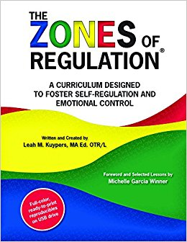
What are The ZONES of Regulation®?
Concept designed by Leah Kuypers, Occupational Therapist
Teaches pupils:
  Vocabulary of emotional terms
  How to recognize their own emotions
  How to detect emotions of others
  How others interpret their behavior
  Calming and alerting strategies
  Problem solving skills
Notes:
categorizes all the different ways we feel and states of alertness into 4 colors

Slide 5
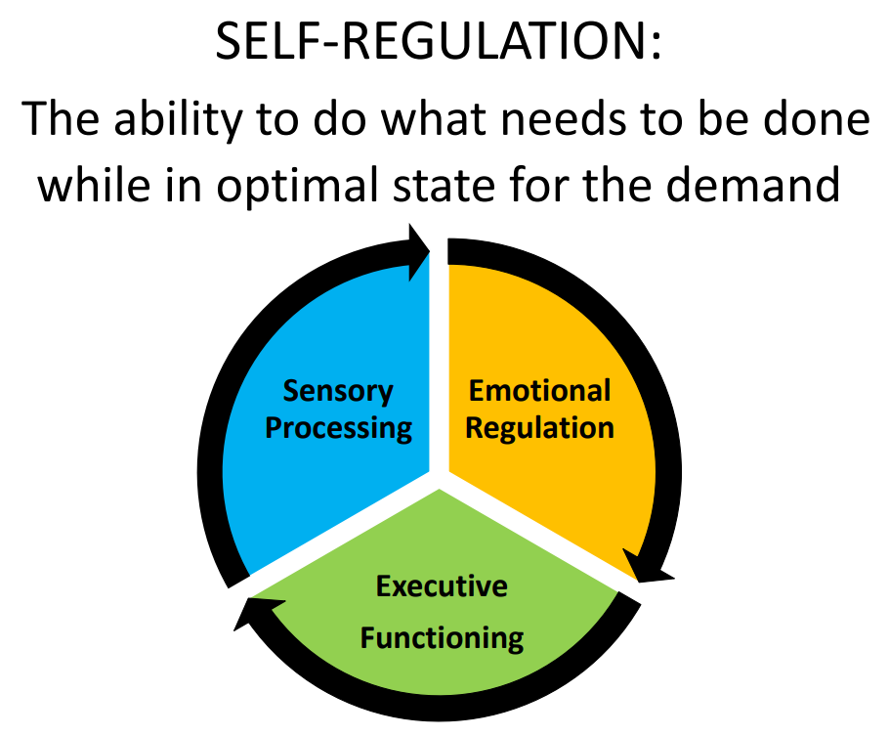
Executive function is a set of mental skills that include working memory, flexible thinking, and self-control. We use these skills every day to learn, work, and manage daily life. Trouble with executive function can make it hard to focus, follow directions, and handle emotions, among other things.
Notes:
Executive function is a set of mental skills that include working memory, flexible thinking, and self-control. We use these skills every day to learn, work, and manage daily life. Trouble with executive function can make it hard to focus, follow directions, and handle emotions, among other things.

Slide 6
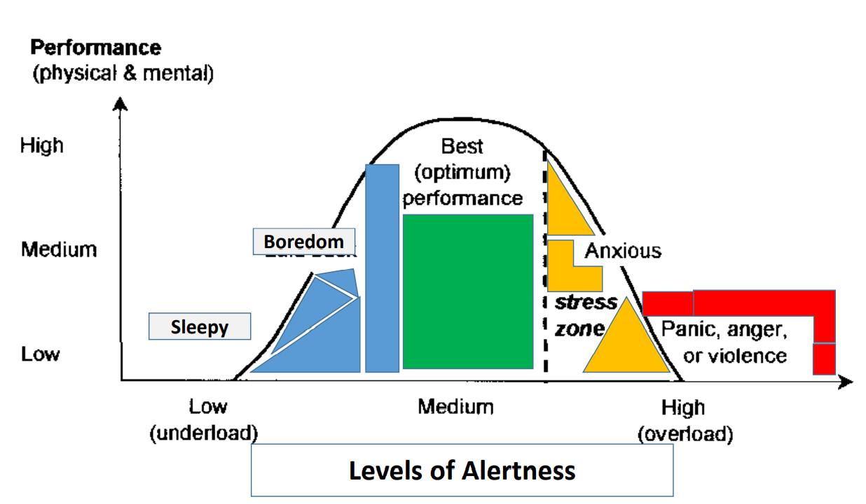

Slide 7
Why teach the Zones?!
  It gives pupils, teachers, and parents a common language to discuss emotions.
  The Zones of Regulation are simple for children to understand.
    Children know the different colours, recognize their feelings and use strategies to move to Green Zone (calm down or feel okay).
  Teaching healthy coping and regulation strategies allows children to help themselves when they become stressed, anxious, or sad.
  Typically, children who can self-regulate will turn into teens who can self-regulate.
  Understanding the emotions of others helps with empathy and friendship skills.

Slide 8
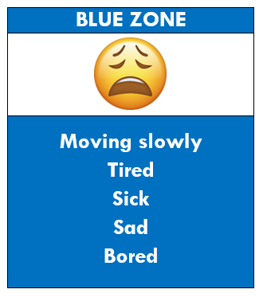
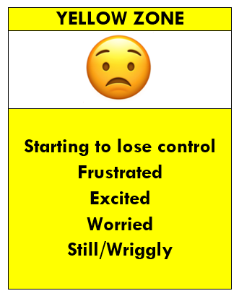
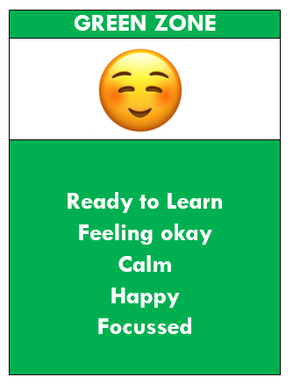
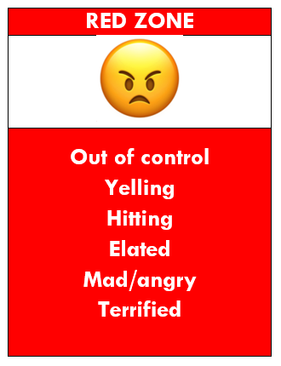





Slide 9
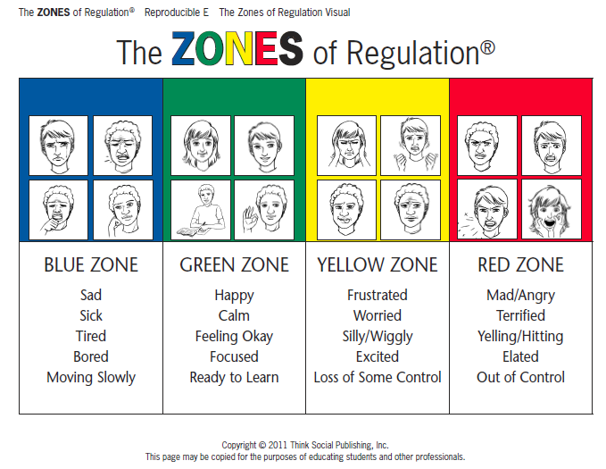
Notes:
All students at TIS have been introduced to the zones. Many already know their strategies to get to green, depending on the class.

Slide 10
What zone would you be in if…
Notes:
Various scenarios

Slide 11
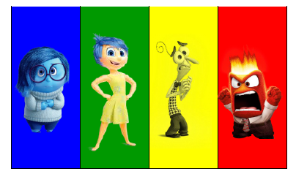
Other ZONES Visuals
Notes:
Inside out relates nicely to the Zones!
Each zone can be appropriate in different circumstances, we aren’t always be expected to be in green. For example, if you came home and your house was being robbed it would be expected for you to be in red, but if you were in the green people might be concerned for you.. ;)

Slide 12
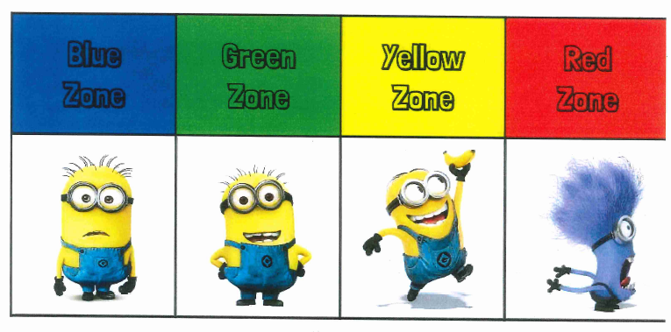
Other ZONES Visuals

Slide 13
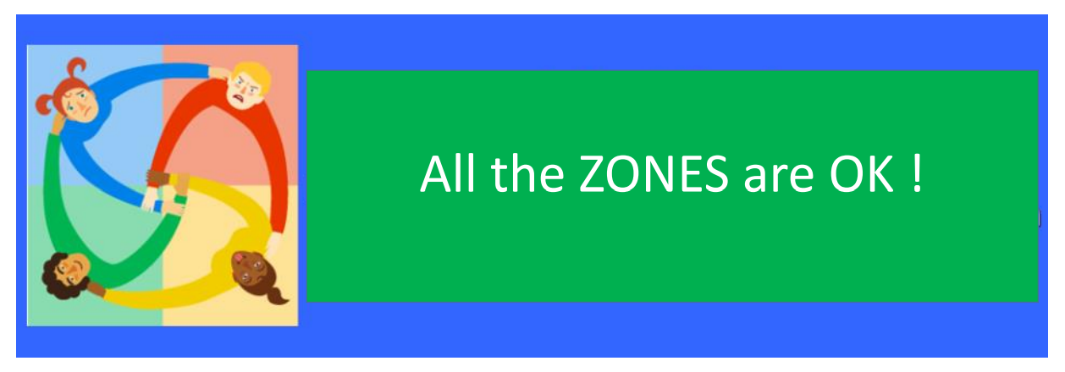

Slide 14
Recognizing emotions is the first step to regulating them
How does your body tell you you’re getting..
Tired?
Stressed?
Frustrated?
Calm?
What clues can we look for to know what zone someone is in?
Notes:
The first thing we want students to know is how to identify feelings in themselves and others. We start by looking for face and body clues and noticing where we feel emotions in our bodies.

Slide 15
How can I support the Zones of Regulation?
• Identify your own feelings using Zones language in front of your child (e.g. “I’m frustrated, I am in the yellow zone”)
• Talk about what tool you will use to be in the appropriate zone (e.g. “I’m going to go for a walk, I need to get to the green zone”)
• Label what zones your child is in throughout the day (e.g. “you look sleepy, are you in the blue zone?”)
• Teach your child what Zones tools they can use (e.g. “it’s time for bed, let’s read a book together in the rocking chair to get to the blue zone”)
• Share how their behavior is affecting your zone (e.g. “It puts me in the blue zone when you ignore me”)
• Post and reference the Zones visuals and tools in your home.

Slide 16
Validate feelings - There is no such thing as a bad ZONE.
Everyone experiences all of the Zones—the Red and Yellow Zones are not “naughty” zones. (e.g., “It’s totally okay to feel angry, but it’s not okay to hit”)
UNEXPECTED RED ZONE TIP
Limit verbals – This is not a teachable moment.
Validate their feelings.
Give them time and space.
Process and teach skills later when calm.
Notes:
When kids are in the red zone, it’s important to give them space to calm down before teaching any strategies or problem-solving.

Slide 17
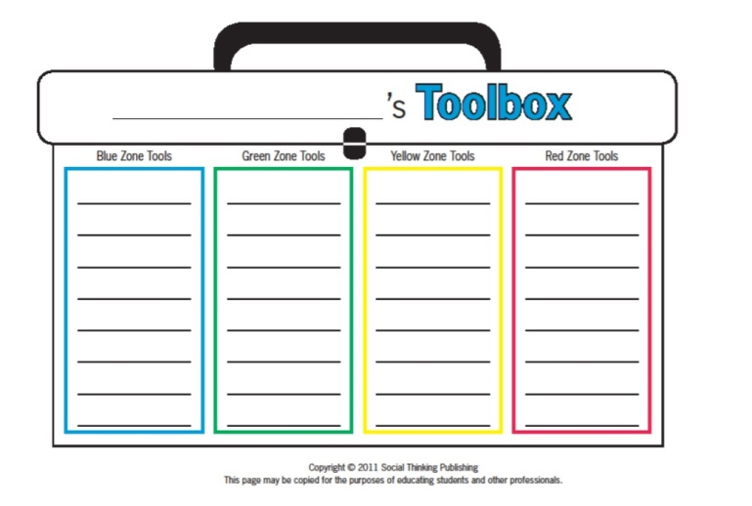
Create toolboxes

Slide 18
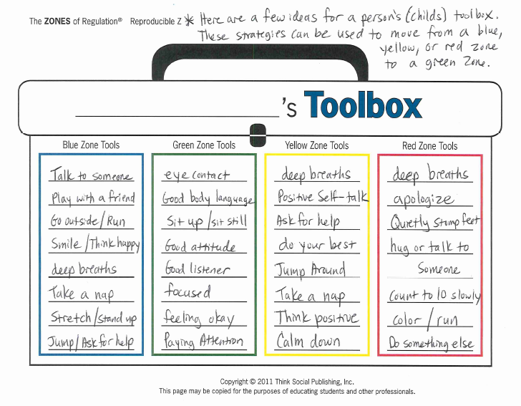

Slide 19
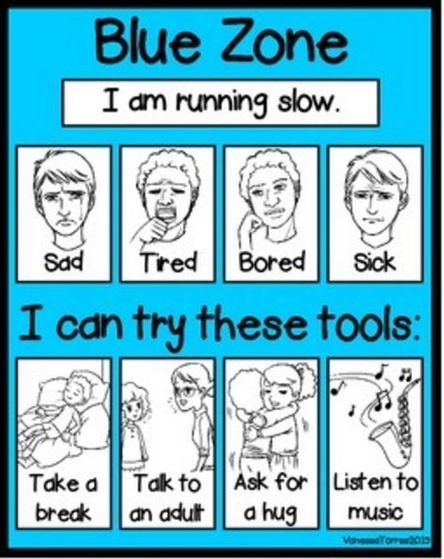
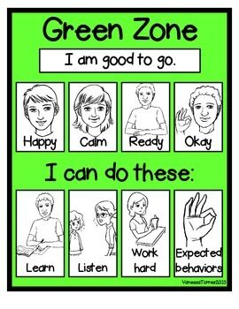
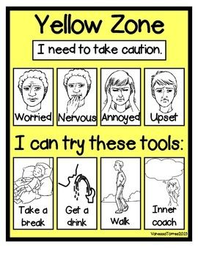
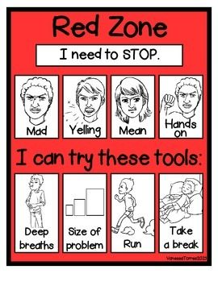

Slide 20
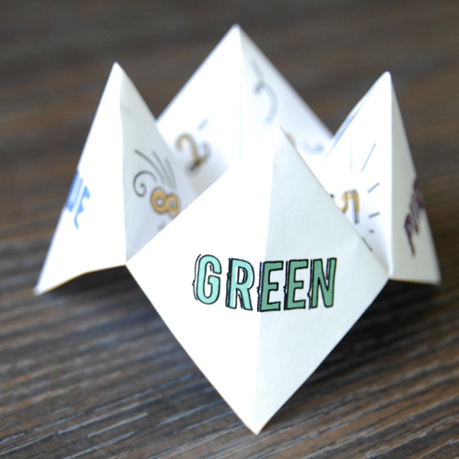
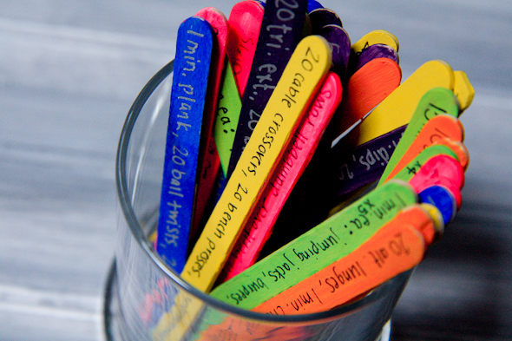
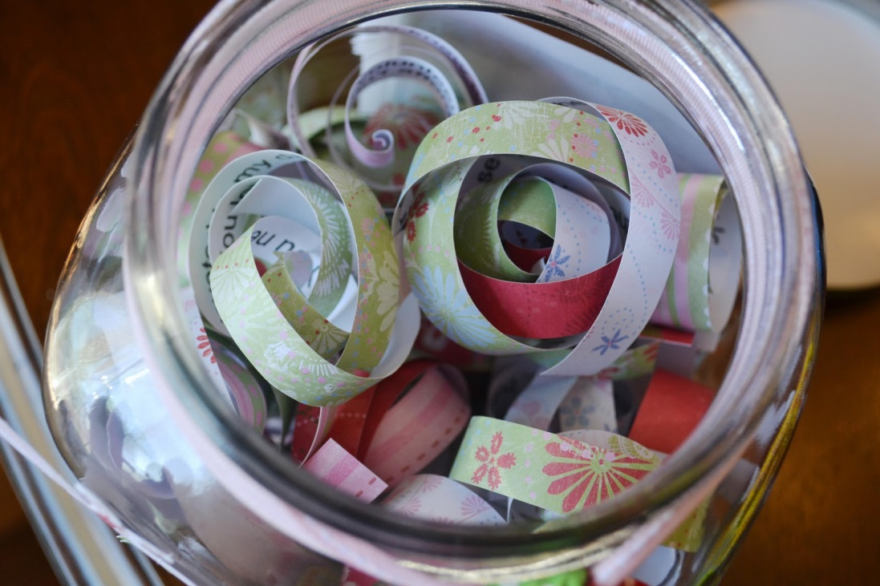
Other toolbox ideas
Notes:
Find endless ideas on Pinterest!

Slide 21
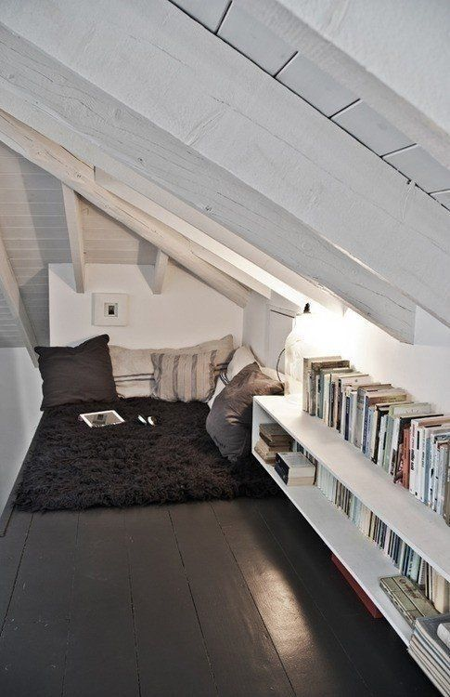
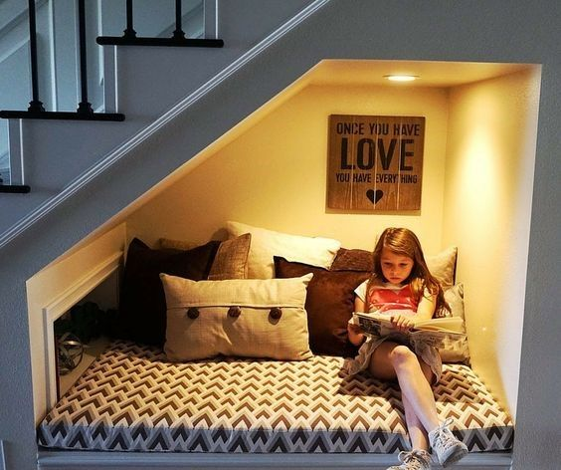
Chill Zone
Quiet Space
Zen corner reading nook
Safe place
Relaxation station
Notes:
You could have a box full of arts and crafts, sensory tools, etc.

Slide 22
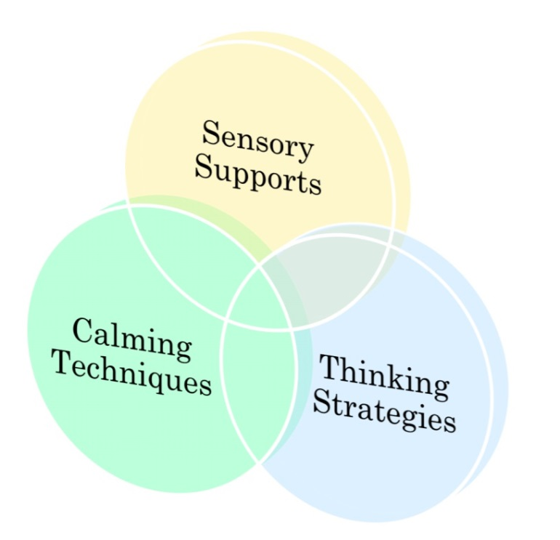
Tools for self-regulation
Notes:
They all overlap but I’ve tried to categorize them

Slide 23
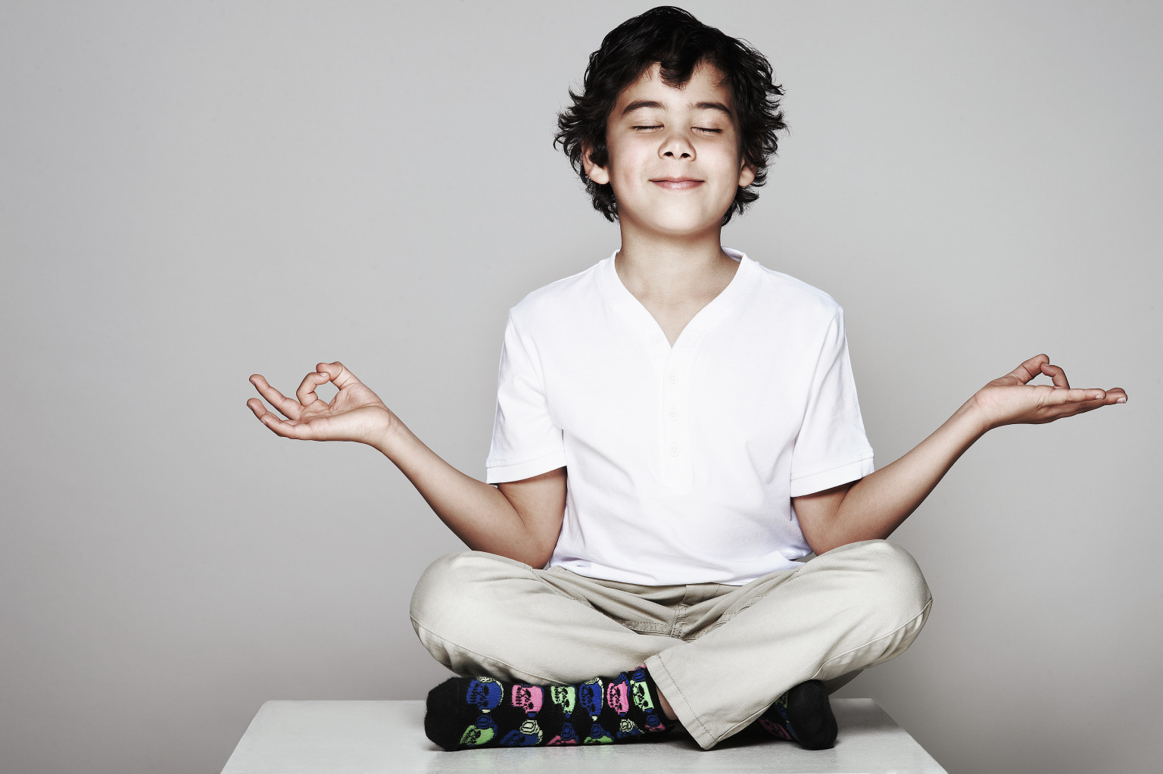
Calming techniques

Slide 24
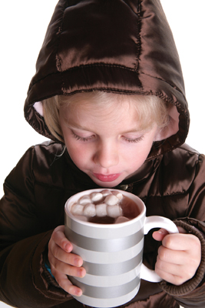
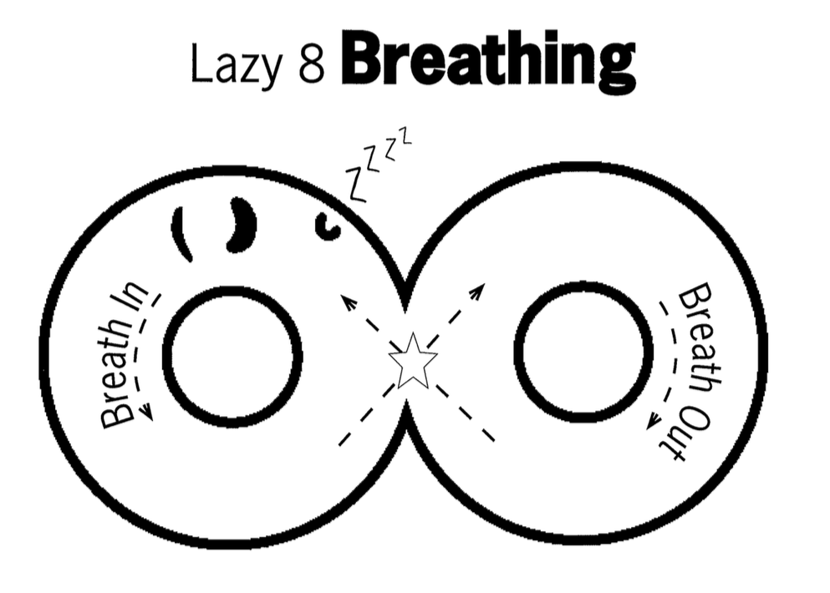
DEEP BREATHING
Notes:
In through your nose, out through your mouth. To help kids remember, I have them imagine they’re smelling hot yummy hot cocoa and then blowing on it to cool it down. Now you imagine you’re favorite hot liquid – coffee, tea, soup – and try it yourself.

Slide 25
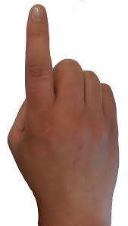
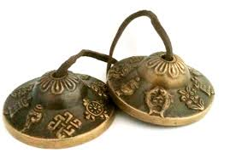

**Mindful Meditation**
Tracing the fingers and counting the breaths in and out

Slide 26
Square breathing

Slide 27
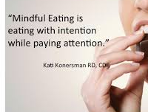

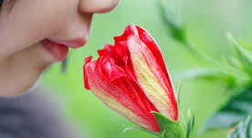
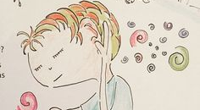
Mindful eating
Mindful touch
Mindful smelling
Mindful listening

Slide 28

Counting
Forward and backward
Count objects
Count colours
Count breaths
Count pulse

Slide 29

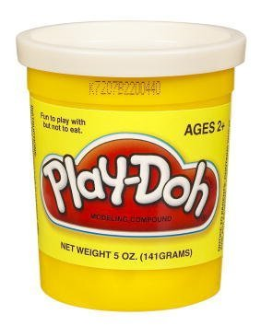

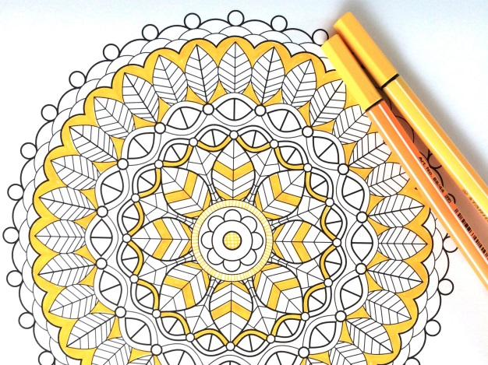
Calming Activities
Puzzles
Listen to Music
Draw/Paint
Origami
Play-Doh/clay
Read
Stack Rocks
Notes:
Coloring books with non-dominant hand

Slide 30
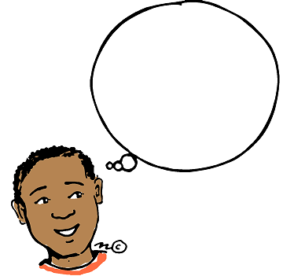
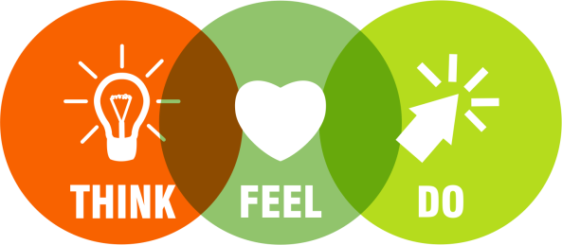
Thinking strategies

Slide 31
Positive Reframing
Argumentative → Truth-seeking
Bossy → Good director / Natural leader
Clingy → Affectionate
Conceited → Confident / Values self
Defiant → Courageous
Demanding → Assertive
Dependent → Connected
Doodles → Creative
Dramatic → Emotionally aware / Expressive
Fearful → Careful
Foolish → Fun loving
Fussy → Strong sense of tastes
Goofy → Joyful / Entertaining
Impulsive → Spontaneous
Loud → Exuberant / Confident
Notes:
Adult example of positive reframing: One day, responding to a widely sent email, she accidentally attached a personal document about her financial difficulties instead of the intended form. Realizing the mistake to her chagrin, she quickly sent out a new email with the message “…Well at least it wasn’t a love letter ;)” Her coworkers got a kick out of her response, and an event that could have caused her to look unprofessional actually improved her coworkers’ opinions of her.

Slide 32
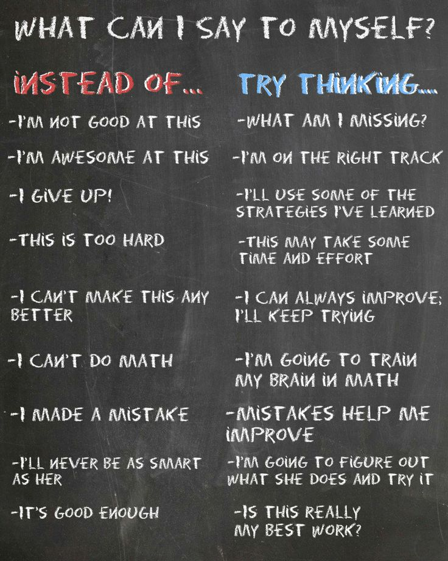

Positive Self-talk
Notes:
AKA our “inner coach”

Slide 33
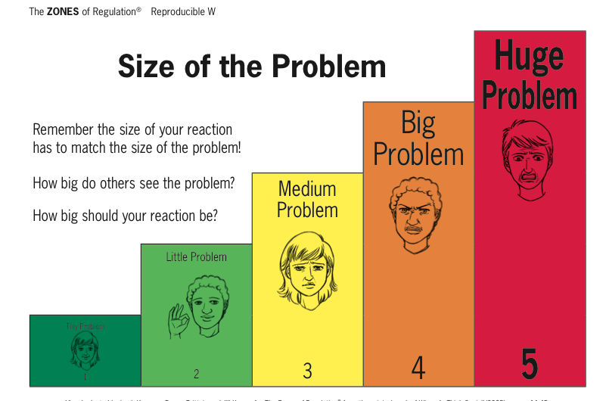
*Talk about which reaction is “expected” in the situation or how a recation may have been “unexpected.”
*Reinforce having an expected reaction
Notes:
Make sure you frequently reinforce your child for have expected reactions rather than only pointing out the unexpected.

Slide 34
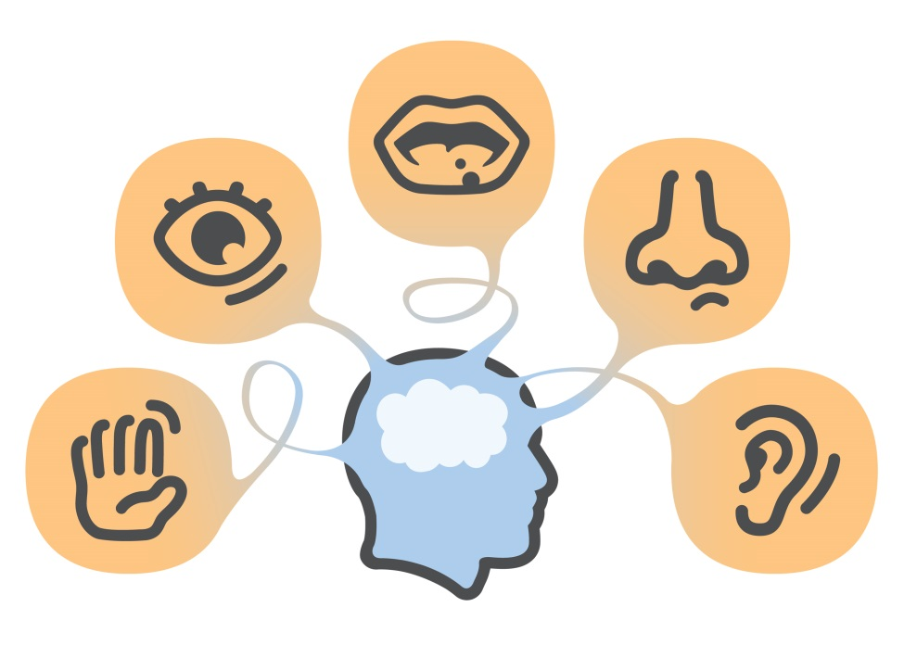
Sensory support

Slide 35

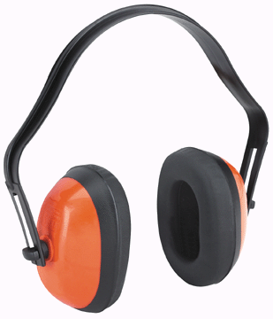
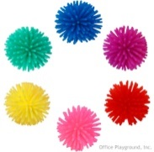

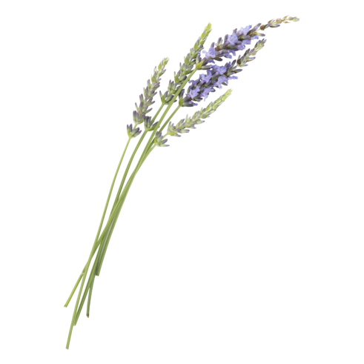
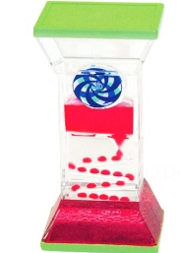
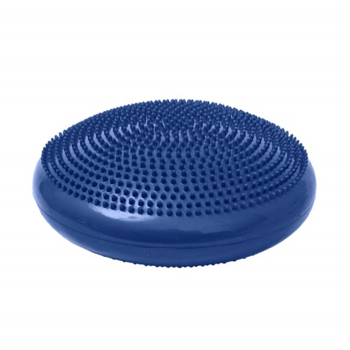
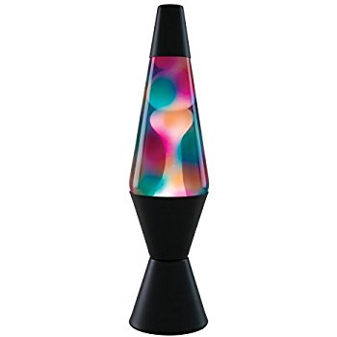
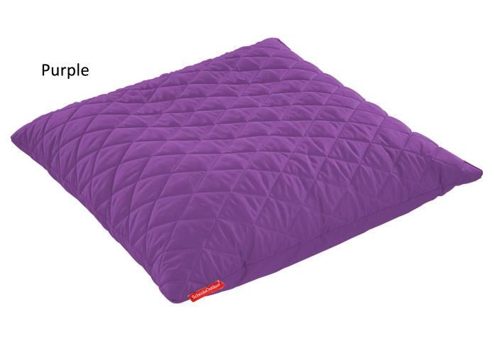
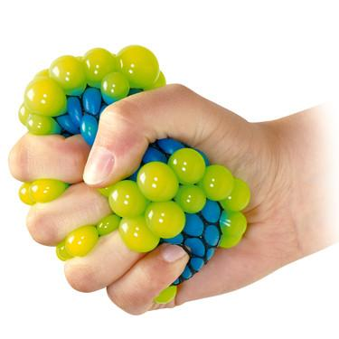
Sensory tools
Notes:
Create your own sensory shakers
Create a sensory bin
Have a IMPORTANT: Self-regulation tools should be available on an as-needed basis or at a scheduled break time. These tools should not be withheld as a consequence or used as a reward.

Slide 36



Sensory strategies
Bear Hug
Spaghetti Noodle
Swing/rock
Go for a walk
Wall push ups
Straw (breath or chew)
Blow bubbles
Classical music
Roll on an exercise ball
Trampoline
Blanket roll
Notes:
Bear Hug = hug yourself suuuuper tight and then let your body fall loose
Spaghetti Noodle = Pretend you’re hard, uncooked pasta (super tense and tight body) and that you’re being cooked (slowly loosen muscles until you flop to the floor like a wet noodle!)
Look at fish tank, snow globes, lava lamp, fireplace, or other slow-moving visual

Slide 37
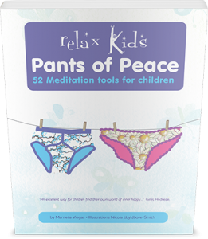
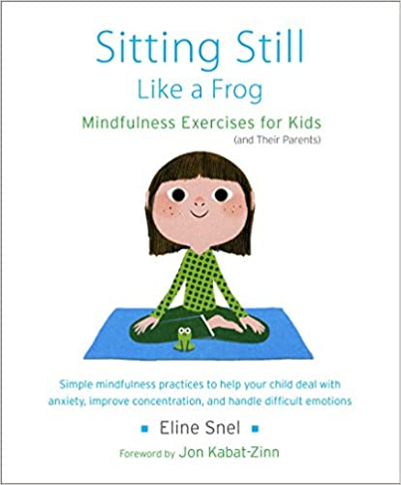

Slide 38
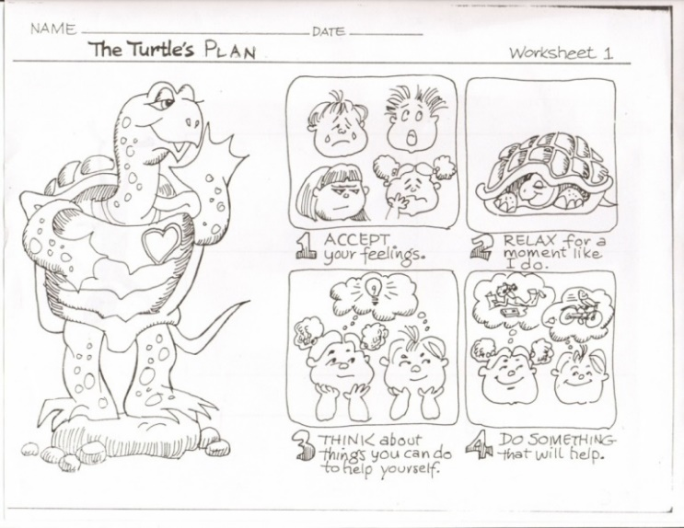
Additional tools

Slide 39
Play games
“Feelings Charades”
Take turns choosing emotions from a stack of cards or papers and act it out using only face and body clues. Guess each other’s emotion, discuss which zone it’s in and why. (Added challenge: Name a tool you’d use when feeling that emotion)
“Name that feeling”
People watch and guess the feelings/zones of others
Name the feelings of characters while watching a movie (and point out any strategies they use)

Slide 40
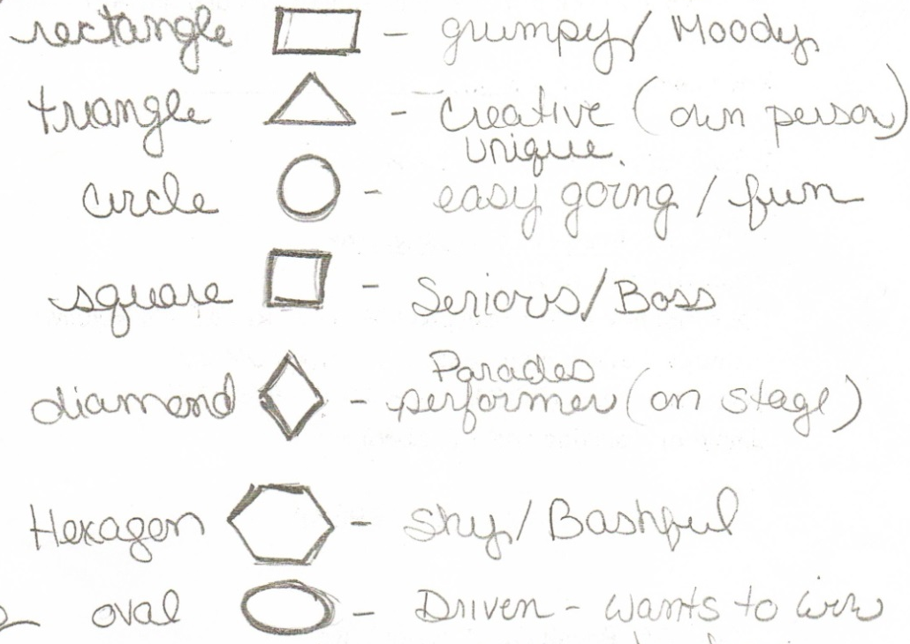

Mood Monsters

Slide 41


Slide 42


Slide 43

Next = problem solving
Once children learn to use their strategies to calm down, they can problem-solve. Children can use STEP and Kelso’s Choices.
Notes:
STEP helps students think of all possible solutions to a problem and predict outcomes of each before picking the best solution.

Slide 44

Kelso’s Choices
Notes:
Solutions for solving social problems in the moment

Slide 45
More Information on The ZONES
Zones of Regulation Website
Zones of Regulation Book and CD on Amazon
Don’t forget about Pinterest!

Slide 46
QUESTIONS?

