Slide 1

The ZONES of Regulation®
Delivered by:-
Mr M. Beach
Assistant Headteacher
Inclusion Manager + KS1 Leader
Notes:
A simple concept that can be used in a lot of useful ways

Slide 2

Aims
To give an overview of the Zones
To outline possible ideas in how to incorporate the Zones at home
To share self-regulation tools
    Calming techniques
    Thinking strategies
    Sensory supports

Slide 3
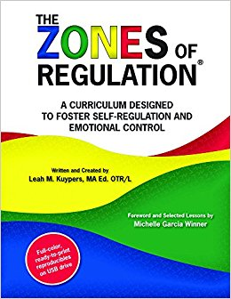
What are The ZONES of Regulation®?
Concept designed by Leah Kuypers, Occupational Therapist
Teaches pupils:
  Vocabulary of emotional terms
  How to recognise their own emotions
  How to detect emotions of others
  How others interpret their behaviour
  Calming and alerting strategies
  Problem solving skills
Notes:
categorizes all the different ways we feel and states of alertness into 4 colors

Slide 4
Why teach the Zones?
  It gives pupils, teachers, and parents a common language to discuss emotions.
  The Zones of Regulation are simple for children to understand.
  Children know the different colours, recognize their feelings and use strategies to move to Green Zone (calm down or feel okay).
  Teaching healthy coping and regulation strategies allows children to help themselves when they become stressed, anxious, or sad.
  Typically, children who can self-regulate will turn into teens who can self-regulate.
  Understanding the emotions of others helps with empathy and friendship skills.

Slide 5
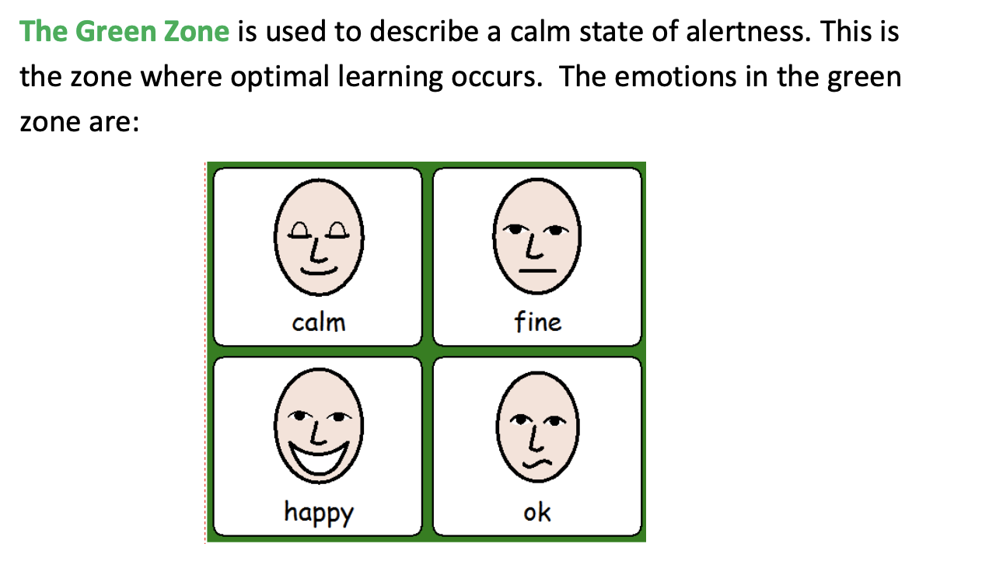
The Green Zone

Slide 6
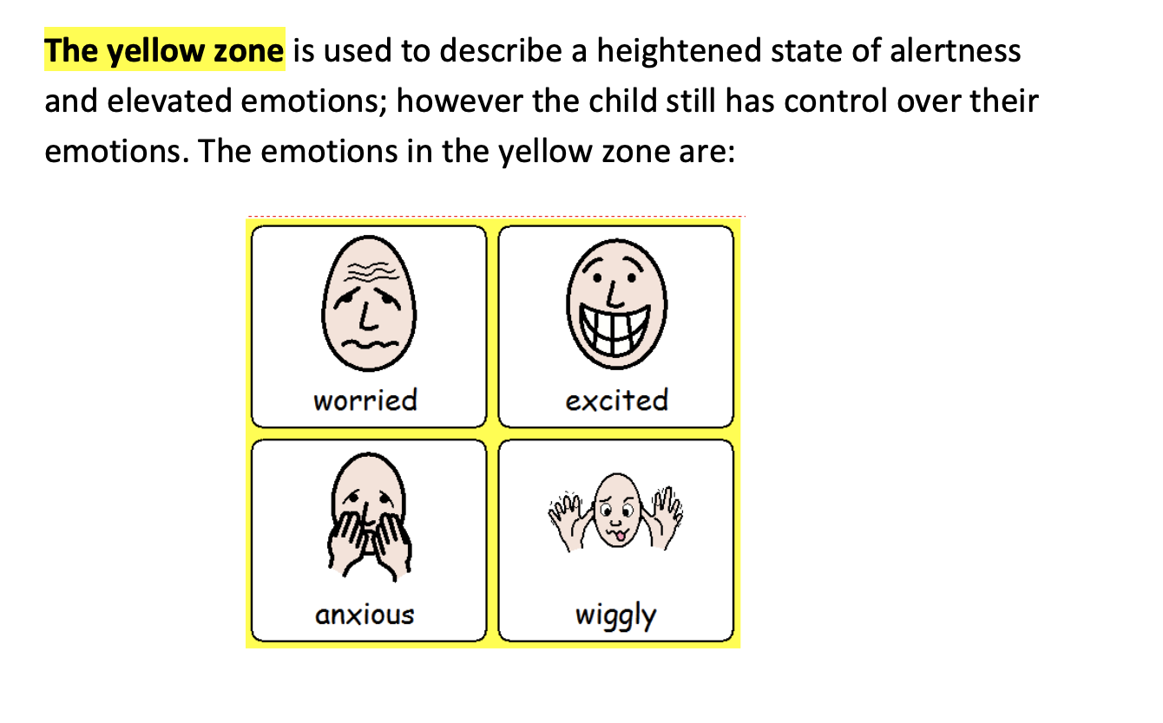
The Yellow Zone

Slide 7
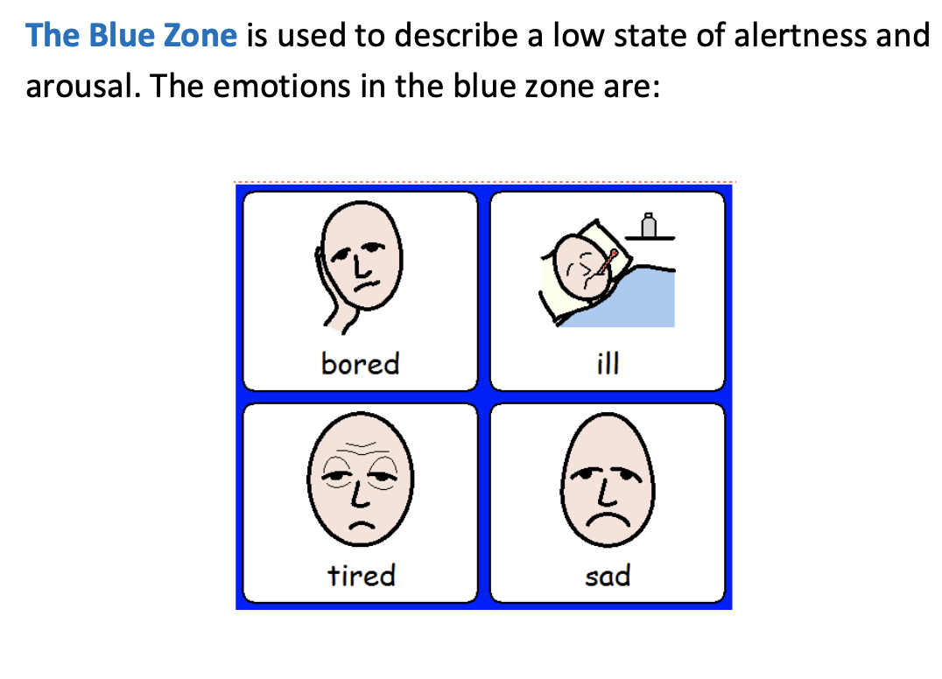
The Blue Zone

Slide 8
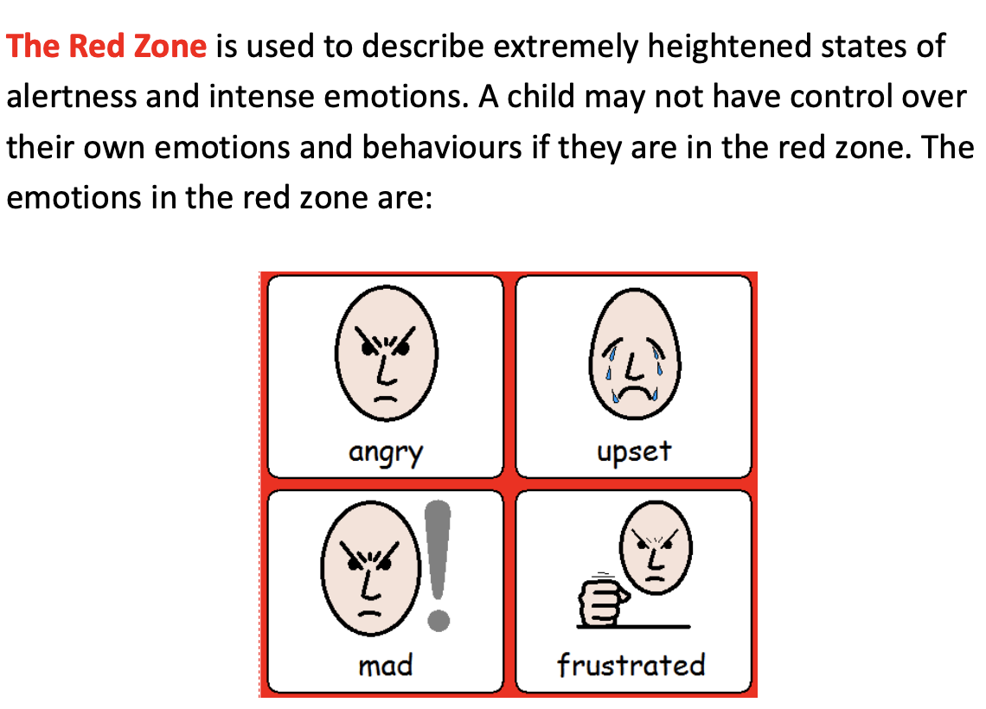
The Red Zone

Slide 9
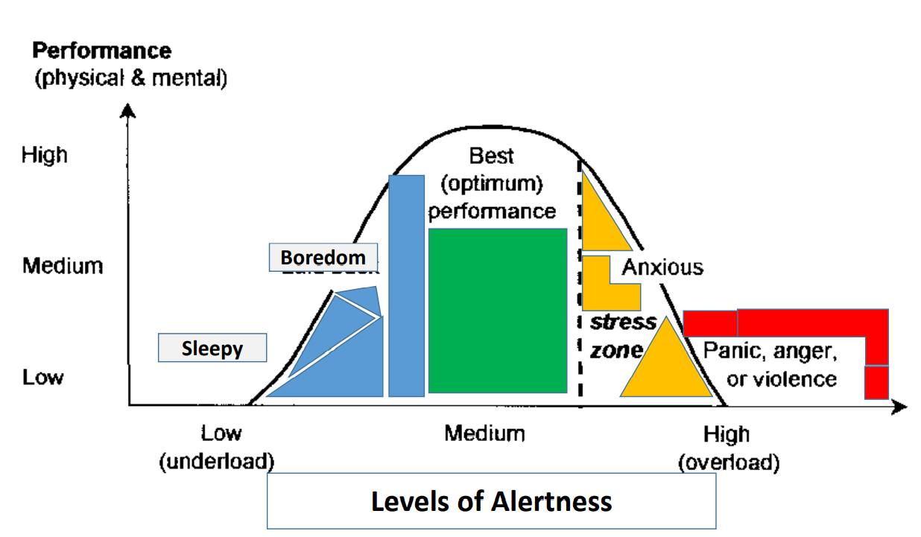

Slide 10
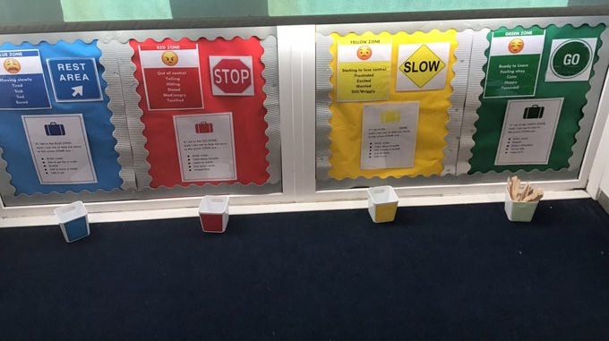
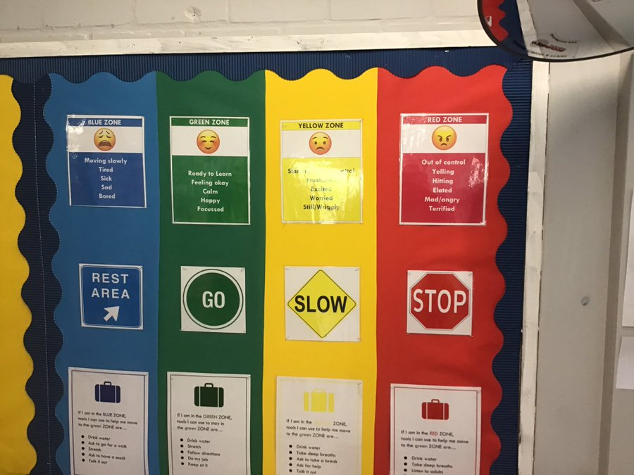
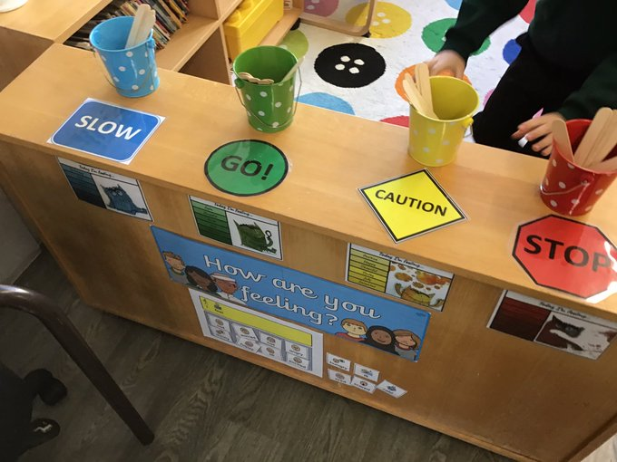
How this is being implemented at Leverstock Green..
Check in stations/displays
Exploring each zone
Developing the language of self-regulation
Tool kits
Sequence of whole school and small group workshops

Slide 11
Recognising emotions is the first step to regulating them
How does your body tell you you’re getting..
Tired?
Stressed?
Frustrated?
Calm?
What clues can we look for to know what zone someone is in?
Notes:
The first thing we want students to know is how to identify feelings in themselves and others. We start by looking for face and body clues and noticing where we feel emotions in our bodies.

Slide 12
How can I support the Zones of Regulation?
• Identify your own feelings using Zones language in front of your child (e.g. “I’m frustrated, I am in the yellow zone”)
• Talk about what tool you will use to be in the appropriate zone (e.g. “I’m going to go for a walk, I need to get to the green zone”)
• Label what zones your child is in throughout the day (e.g. “you look sleepy, are you in the blue zone?”)
• Teach your child what Zones tools they can use (e.g. “it’s time for bed, let’s read a book together in the rocking chair to get to the blue zone”)
• Share how their behavior is affecting your zone (e.g. “It puts me in the blue zone when you ignore me”)
• Post and reference the Zones visuals and tools in your home.

Slide 13
Validate feelings - There is no such thing as a bad ZONE.
Everyone experiences all of the Zones—the Red and Yellow Zones are not “naughty” zones. (e.g., “It’s totally okay to feel angry, but it’s not okay to hit”)
UNEXPECTED RED ZONE TIP
Limit verbals – This is not a teachable moment.
Validate their feelings.
Give them time and space.
Process and teach skills later when calm.
Notes:
When kids are in the red zone, it’s important to give them space to calm down before teaching any strategies or problem-solving.

Slide 14
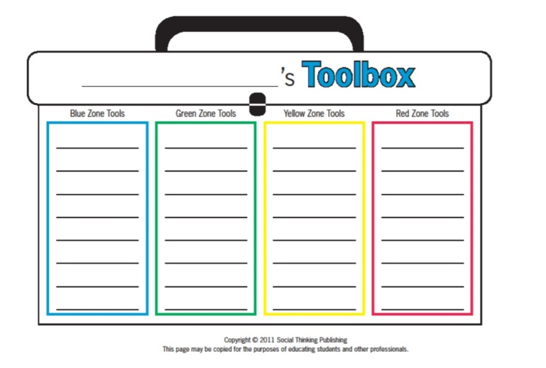
Create toolboxes

Slide 15
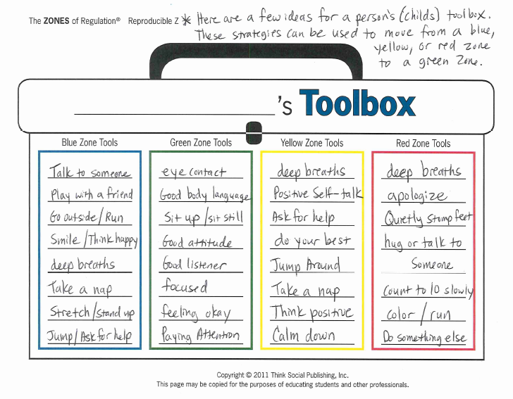

Slide 16
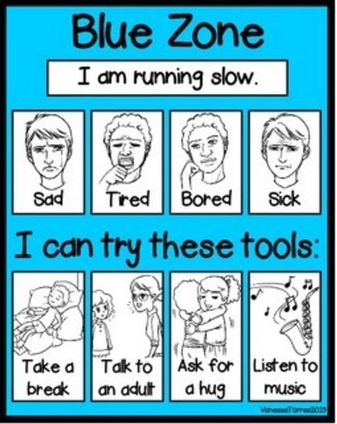
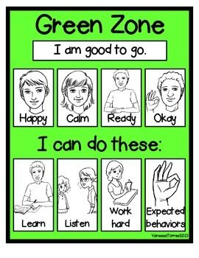
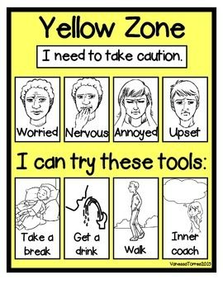
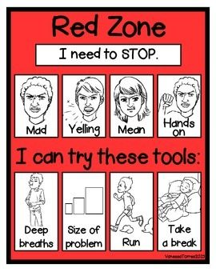

Slide 17
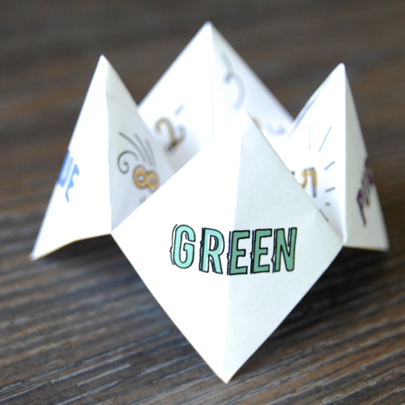
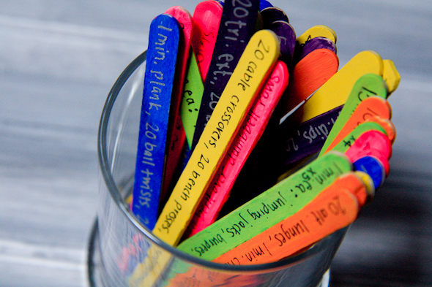
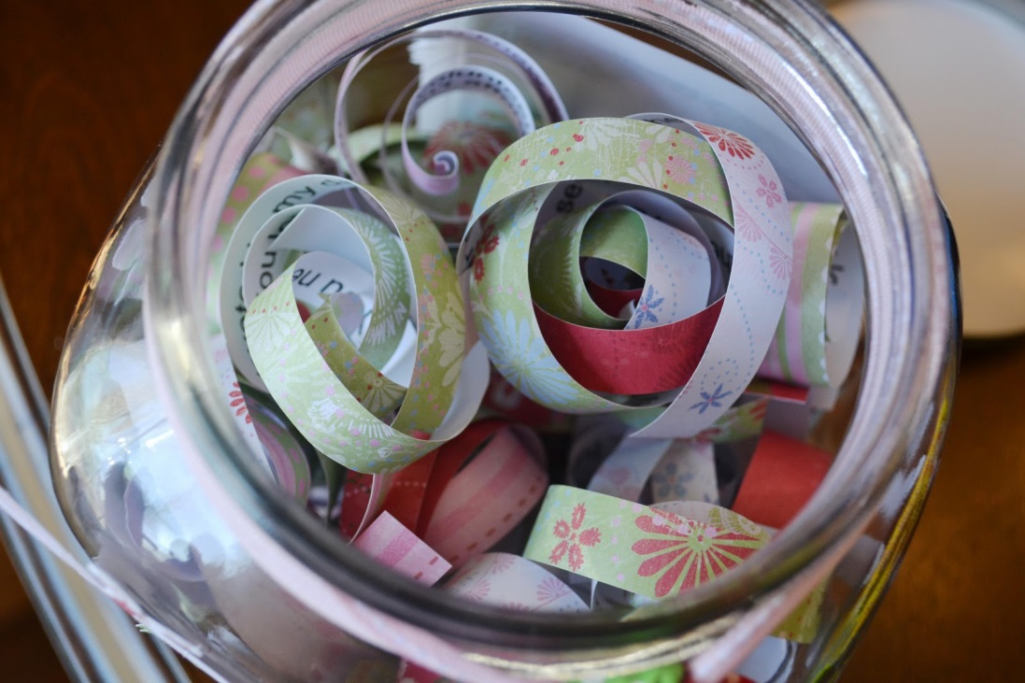
Other toolbox ideas
Notes:
Find endless ideas on Pinterest!

Slide 18
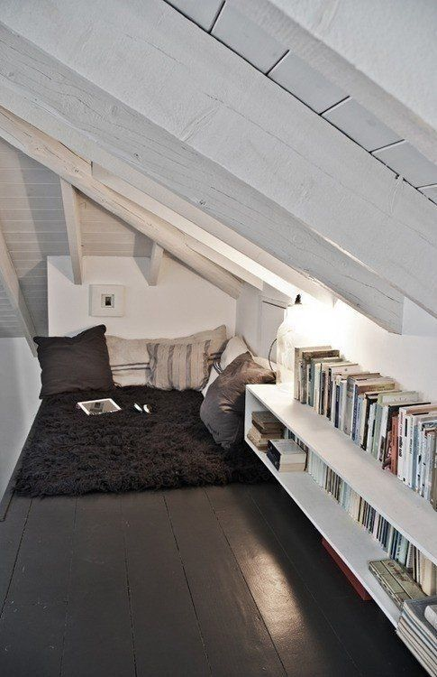
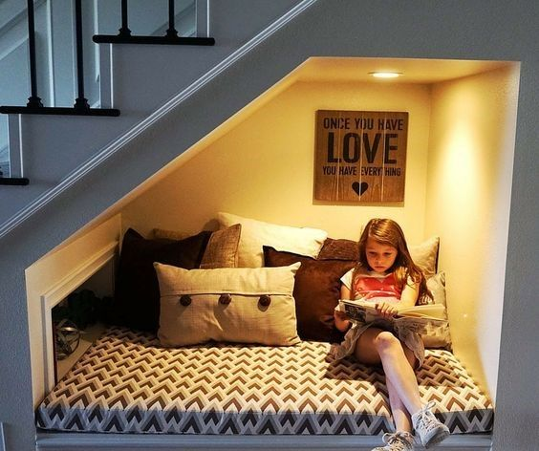
Chill Zone
Quiet Space
Zen corner reading nook
Safe place
Relaxation station
Notes:
You could have a box full of arts and crafts, sensory tools, etc.

Slide 19
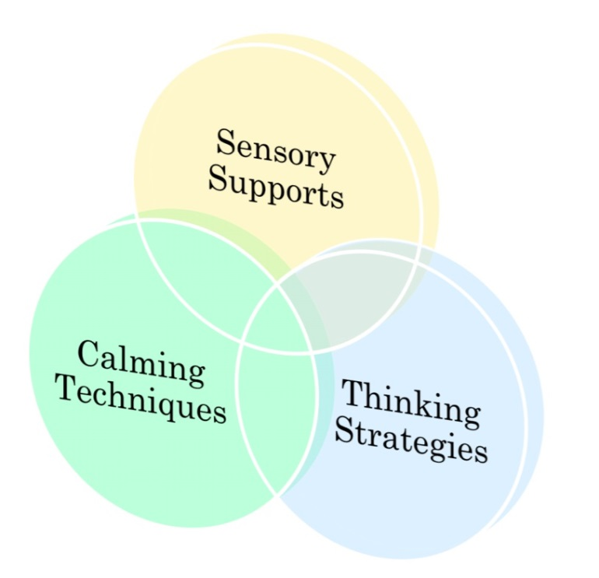
Tools for self-regulation
Notes:
They all overlap but I’ve tried to categorize them

Slide 20
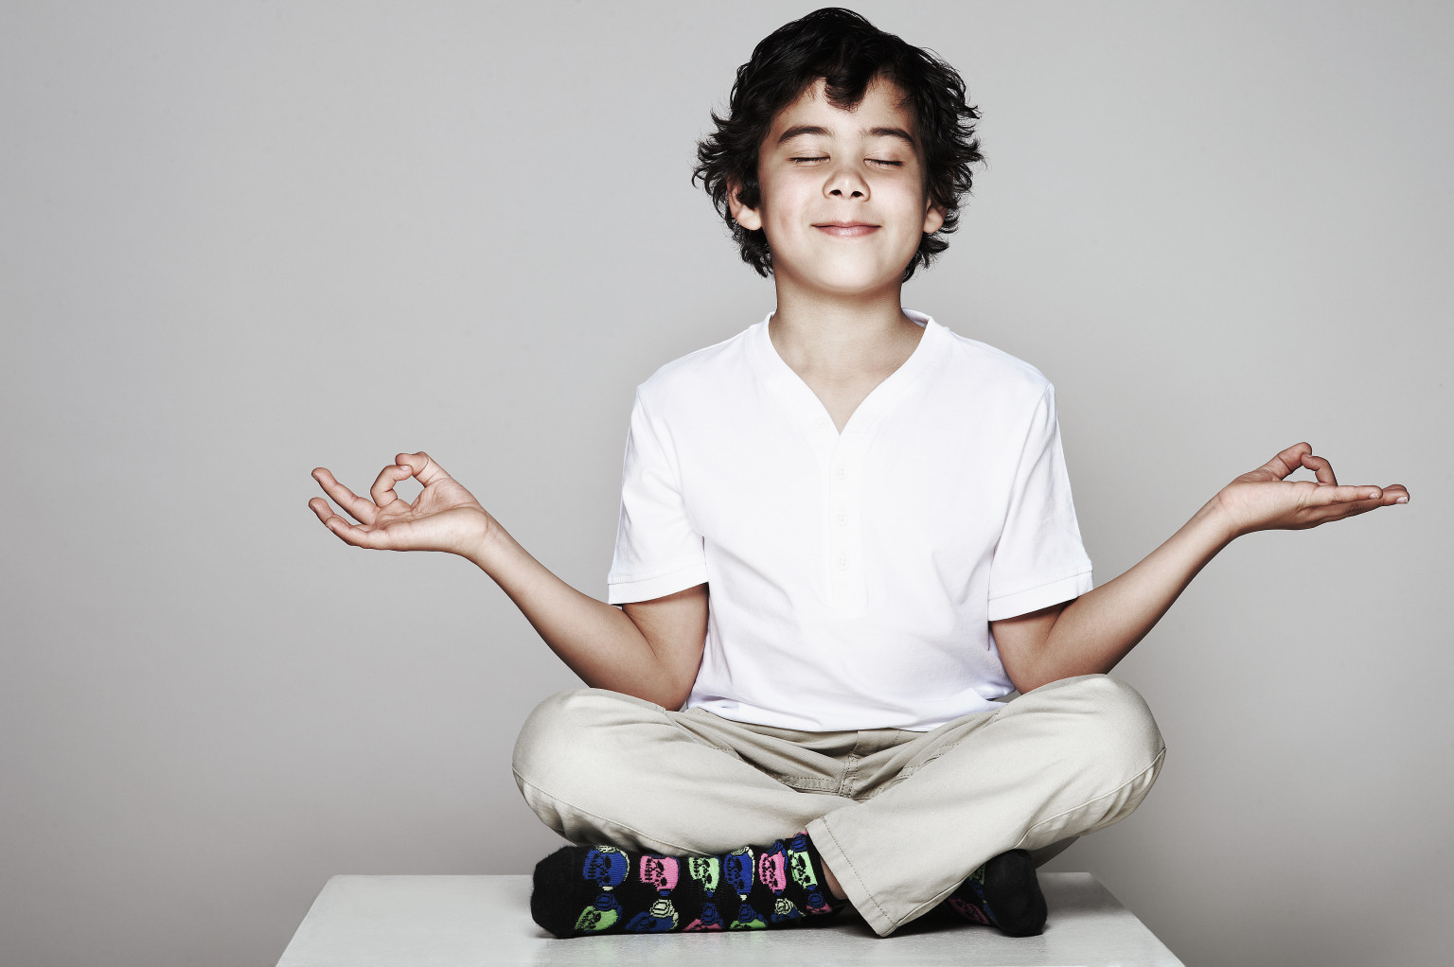
Calming techniques

Slide 21
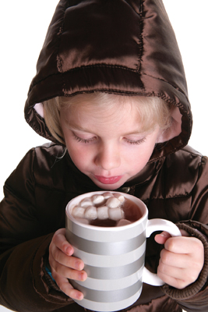
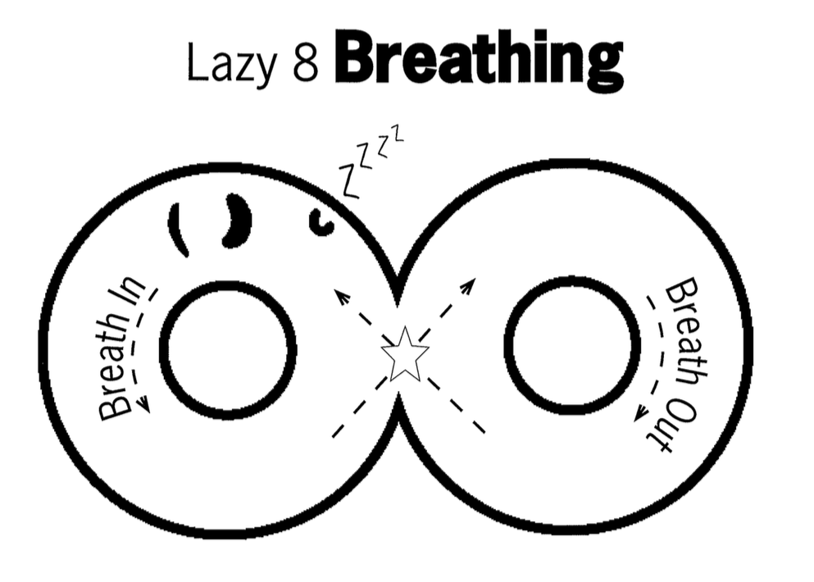
DEEP BREATHING
Notes:
In through your nose, out through your mouth. To help kids remember, I have them imagine they’re smelling hot yummy hot cocoa and then blowing on it to cool it down. Now you imagine you’re favorite hot liquid – coffee, tea, soup – and try it yourself.

Slide 22
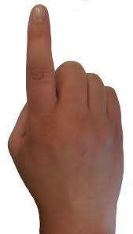
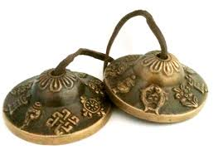
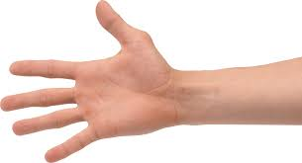
Mindful Meditation
Tracing the fingers and counting the breaths
in and out

Slide 23
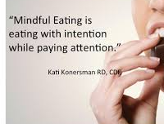

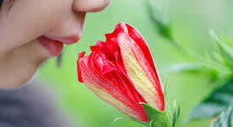
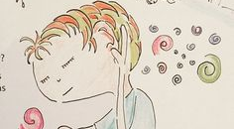
Mindful eating
Mindful touch
Mindful smelling
Mindful listening

Slide 24

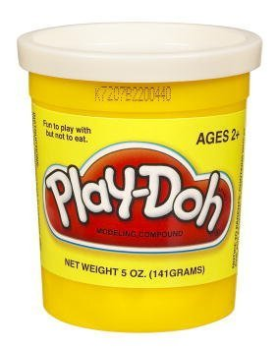

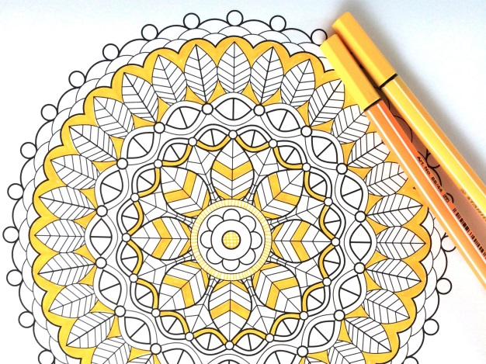
Calming Activities
Puzzles
Listen to Music
Draw/Paint
Origami
Play-Doh/clay
Read
Stack Rocks
Notes:
Coloring books with non-dominant hand

Slide 25

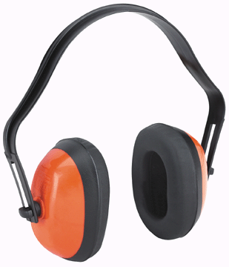
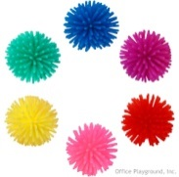

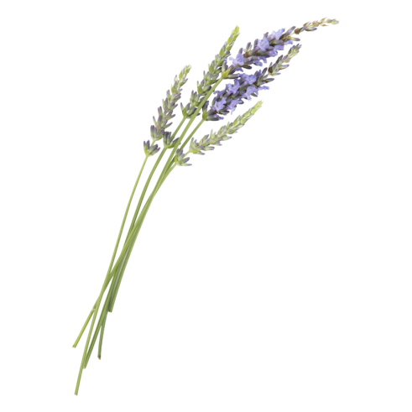
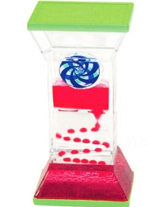
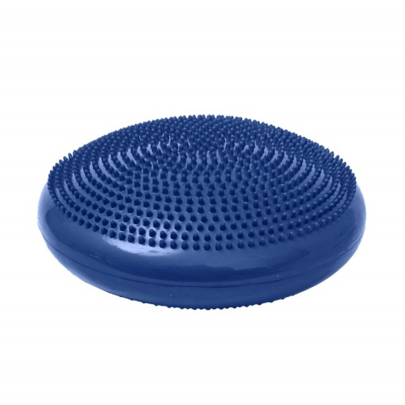
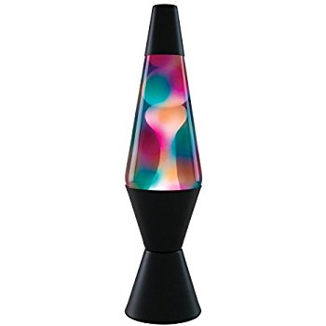
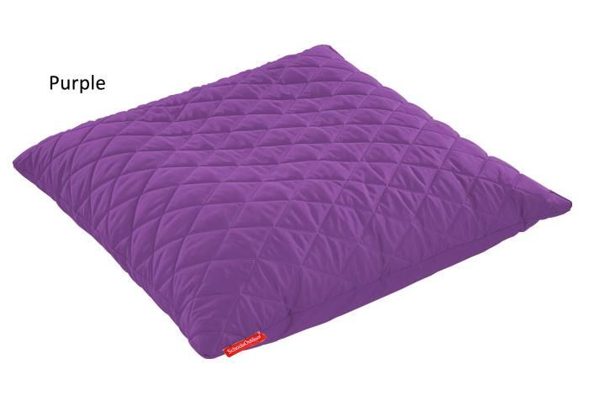
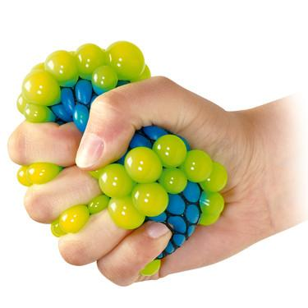
Sensory tools
Notes:
Create your own sensory shakers
Create a sensory bin
Have a IMPORTANT: Self-regulation tools should be available on an as-needed basis or at a scheduled break time. These tools should not be withheld as a consequence or used as a reward.

Slide 26
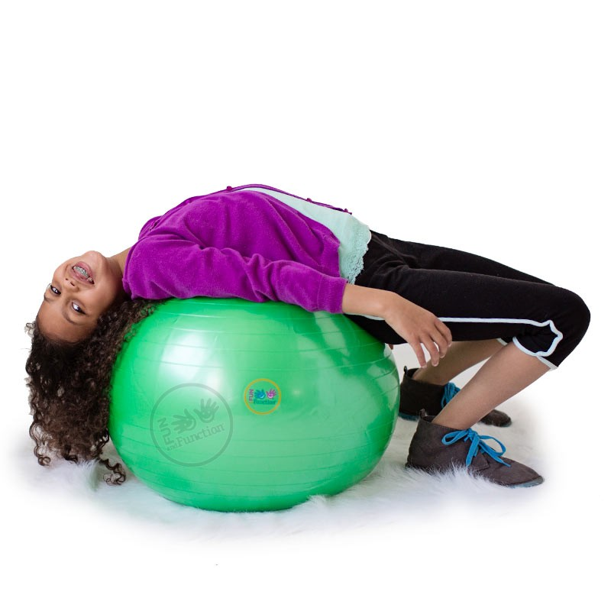
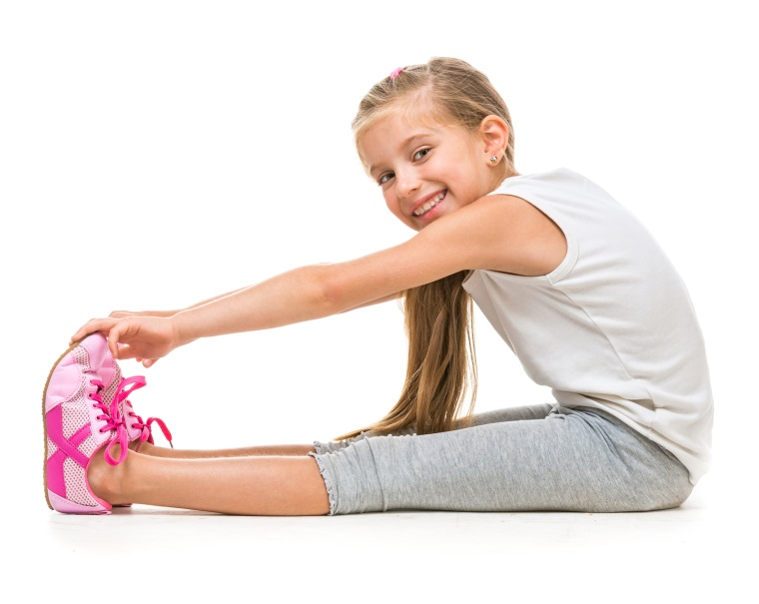

Sensory strategies
Bear Hug
Spaghetti Noodle
Swing/rock
Go for a walk
Wall push ups
Straw (breath or chew)
Blow bubbles
Classical music
Roll on an exercise ball
Trampoline
Blanket roll
Notes:
Bear Hug = hug yourself suuuuper tight and then let your body fall loose
Spaghetti Noodle = Pretend you’re hard, uncooked pasta (super tense and tight body) and that you’re being cooked (slowly loosen muscles until you flop to the floor like a wet noodle!)
Look at fish tank, snow globes, lava lamp, fireplace, or other slow-moving visual

Slide 27

Thank you for coming.
What questions do you have?

